Slide 1

The Charter of the People of Canaan
Canaan Farmers Training Center Medan, Indonesia

Slide 2
Work at least four hours for each meal
Bekerja setidaknya empat jam untuk setiap makan
Why not 8 hours a day but 12 hours a day ?
Mengapa tidak 8 jam sehari tetapi 12 jam sehari ?
To escape from poverty & To have better life
Untuk melarikan diri dari kemiskinan & Untuk memiliki kehidupan yang lebih baik
If we work 8 hours a day like the people of developed country, we cannot catch up with them.
Jika kita bekerja 8 jam sehari seperti orang-orang di negara maju, kita tidak dapat mengejar mereka

Slide 3
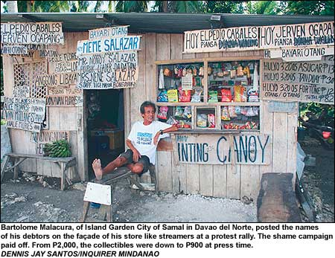
No earning, no spending (Tidak ada penghasilan, tidak ada pengeluaran)
Debt Accumulation
(Akumulasi Utang)
Spend w/o earning Belanjakan tanpa penghasilan
Depend on Others (Bergantung pada Orang Lain)
Balance of Income and Expense (Neraca Pendapatan dan Pengeluaran)
Example:
Recording Income and Expense
(Contoh:
Mencatat Pemasukan dan Pengeluaran)

Slide 4
3. Do not be forced to live poorly, but force yourself to live well
Poverty is not fate
Challenge their life
Everything was provided what man need to live in this earth
Pick & Utilize
Everything in the earth
Man
Through Work
Force to live poorly means they don’t work even if they can.
Forced to live well means that we have to challenge ourselves to live well, even though various circumstances make it difficult for us to live well.

Slide 5
Be a citizen who knows the right way of using materials, power, knowledge and technology
Miss using of
Material
Loss & make life difficult
Time
Loss & lose credibility
Power
Oppress the people and
no protection
Knowledge &
Technology
Destroy the society
A good knife is used to cook delicious food when given to a housewife, but if given to a robber, it hurts people

Slide 6
Be free from material and mental indebtedness
When person has material and mental indebtedness, not only his body but also his spirit is not free
Material Indebtedness
Poverty
Mental Indebtedness
Mental Colony
Instead, saving & Independent
How can you save money and increase your capital ?
Reducing household expense
Always possible with plan
Save from unnecessary expense
Month: $30.-, Year: $360.-, After 10 Years: $3,600
Saving $5,000- including interest

Slide 7
Demonstrate the excellence of our people through our work, mind and action
A nation consists of each individual of the nation, and the future of a nation depends on the behavior of each individual citizen
Patriotism starts from self love and self respect, which lead us to love the nation.
How can you show the excellence of your people?
Find – Promotion – Demonstration
Ex) To make good quality of products. To show the good performance of work. Using good quality of attitudes.
The total combination of excellence of the individual becomes the national excellence

Slide 8
Make our mind attractive before we make our outward appearance beautiful
The making of the appearance beautiful may be accomplished by make-up, and the making of the mind attractive is a training of the personality..
The face made of cosmetics will not last long, but the beautiful mind last forever.
A man who has developed a beautiful mind is always seeking for the truth for himself.
The man who has made his appearance attractive is always seeking reputation.

Slide 9
How can we make our mind attractive?
Have a pure & sincere heart
Can get wisdom from heaven
Talk with heart
Can get trust from others
Don’t lie and pretend
Will gain everything

Slide 10
8. Do not conform to foreign fashion but rather support our people's sensitivity
This is principle for the proper advancement of culture.
Because if one copies just foreign trends, the original culture will be lost, resulting in the loss of the individual and the nation.
But we should not stick only to our original culture in order not to be behind while disregarding the sense of the age.
Therefore, the adjustment should be made according to the sense of the age..
Respect our own culture and support our people’s sensitivity while considering the sense of the age.

Slide 11
Economical Aspect
Using foreign brand
Outflow of money to abroad
No domestic investment
No job creation
Using domestic brand
New investment
Job creation
Buy Domestic Brand

Slide 12
Unite our family and neighbor first even before uniting our country as a whole
The cordial and consolidated relationship can not be created by force, but are made possible only by love.
Unification of family & neighbor
Unification of country

Slide 13
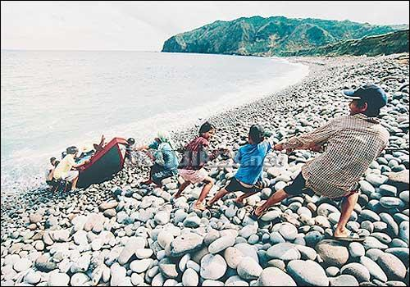
Unity
HANDS ON. The stone-studded steep incline makes it tough for children earning their keep by helping fishermen draw up boats to the shorelines of Barangay Valugan, Basco, Batanes. But everyone in this coastal town feels obliged to lend a helping hand as they believe that their survival depends on their working together as one community. INQUIRER 4/26/07

Slide 14
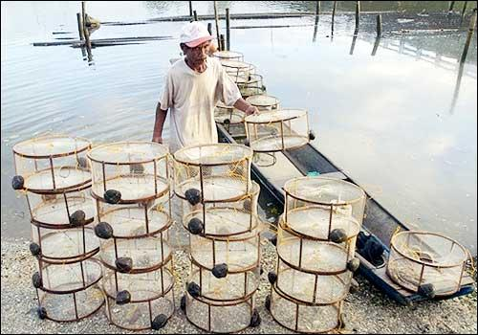
10. Do not be a man to be told what to do, but be a man who initiates his own work
TRAPPINGS Romeo Istanislao, 67, unloads his shrimp traps after a day's work at a river that passes through San Isidro in Negros Occidental. He earns about P350 ($7.21) a day, a respectable amount in the province where poverty is widespread even though the island is the sugar capital of the Philippines. AFP/JAY DIRECTO March 10, 2007
Passive
Activity
Grab opportunity & don’t lose it

Slide 15
11. If our body is deeply asleep, our materials will be stolen; If the nation is deeply asleep the sovereignty will be stolen; If our spirit is deeply asleep, our soul will be ruined
Loss of Material
& Health
Poverty &
Death
Body Asleep
Loss of Territory &
Sovereignty
Physical or Mental
Colony
Nation Asleep
Ruin of Soul
Eternal Punishment
Spirit Asleep
Always Wake Up

