Slide 1

Life Toward Canaan
Canaan Farmers Training Center Medan, Indonesia

Slide 2
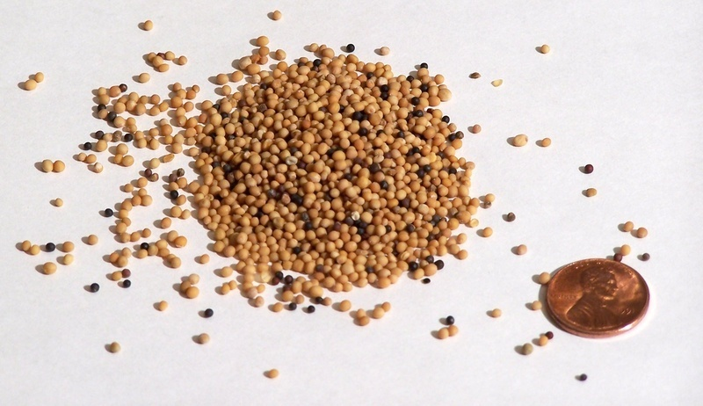

How can we start to cultivate our life toward better life ?
Big project or program
No
Transformation of Mindset
Yes
Prosperity
Legacy
Need a small thing like a mustard seed
Planting Mustard Seed
Big Tree
Mustard Tree
Mustard Seed

Slide 3
Small thing like mustard seed
You
Your Family
Change
Your Community
Youre Nation
Three things to practice the success of transformation
First, we must have three senses
Second, revolution of our living attitudes
Third, know six elements to achieve goal

Slide 4
1). Three senses of life
1) Sense of purpose
We should have a definite sense of purpose
If we set the purpose in this world
End in the world
If we set the purpose in eternity
Continue forever
“We are not born accidently”
We should know what is our purpose to live in the earth

Slide 5
2) Sense of Responsibility
The meaning of responsibility:
- The fact of having an obligation to do something
- The state of having control over or care for someone
- The state of being capable of being trusted
As a Human Being
Responsibility
As a Family Member
As a Student
As a Employee
Right
As a Community Member
As a Citizen

Slide 6
3) Sense of Mission
General Meaning of Mission
An important assignment carried out for political, religious, or commercial purposes, typically involving travel
The vocation or calling of a religious organization, especially a Christian one, to go out into the world and spread its faith
The meaning of mission in Canaan
A man’s faithful performance of his work
Work Performance
Work with mission
Work without mission
If a man is pious to his parents by his own will, that is the mission; and if he does it simply because someone else does, then it is not the sense of mission..
Everything should be done with the sense of mission

Slide 7
The life of Human Being
Sense of Purpose
Sense of Responsibility
Sense of Mission
Completion
(Finish, Accomplishment)

Slide 8
2. Revolution of Living Attitude
Expose all bad customs, habits and tradition
physically and spiritually
Redressing
Selection of 10 major bad customs, habits and tradition yourself

Slide 9
the foundation of life is inside the mind, and . . . . the rise and fall of a nation depends on the mind of the citizen. –Elder Yong Ki Kim –
Change myself first!
Change here first!
Change now first!
Change small thing first!
Change doable things first!
Change until the end!

Slide 10
Transforming Society
Transformation
Change myself first!
Nation
Family
Community
Individual
Transformation
Fruits

Slide 11
3. Six elements to achieve the goal
1) Vision
You must have a vision
A vision is a spiritual picture of the result you want to achieve
A vision is not a vague wish or hope, but it is a picture of the real outcome of real effort.
Benefit
Vision
Clearly define a roadmap for the life
Should
Inspire to act and to think forwardly
Clear
Give practical guideline
Positive
Big Enough
Help to avoid detour or distraction

Slide 12
2) Self Confidence
Even if you have a vision, your vision will not come true if you don’t have self confidence
Meaning of Self Confidence
A feeling of trust in one's abilities, qualities, and judgment.
Positive Effects of Self Confidence
- Can have better performance: Instead of wasting energy and time worrying about your own shortcomings, you can focus your energy on your efforts
- The challenge trying new things: When you believe in yourself, you're more willing to try new things
- Resilience: Believe in yourself and you will strengthen your ability to overcome all the difficulties you face in life
- Healthy relationship with others

Slide 13
The Way to Build Up Self Confidence
- Don’t Compare Yourself to Others
Everyone is running their own race of life and life is not a competition
- Be Generous with Yourself
Self-compassion is being kind to yourself when you make mistakes, fail, or experience setbacks
- Practice Positive Self-Talk
Using optimistic self-talk can help you develop self-compassion, overcome self-doubt, and take on new challenges
- Face Your Fears
Some of your fears stem from a lack of self-confidence
You might learn that being a little anxious or making mistakes is not as bad as you thought

Slide 14
3) Must Know the Reason of Existence
All of you came to the earth not by incident or accident because you are only one in this world.
You came to the earth by the invisible great power
You must know that you are most valuable person in this earth
You are existing in the world to be loved
4) Take Action
Even if you have a vision, confidence and know the reason of existence, if you don’t take action, it will be useless
It's easy to get excited about a vision, but often the vision doesn't translate into action
Turn Vision into Action
Not talk, but take action

Slide 15
5) Continuity
If you stop in the middle of starting, what you have been doing in the past will be useless
Once start, don’t stop and finish it
Success
6) Keep Moving Forward
Moving forward means not accepting it when life gets tough.
It means that you are willing to keep going even when things are difficult.
Moving forward also means that you do not allow external circumstances to stop you from the pursuit of your goals.
Keep moving forward until you reach goal

Slide 16
History
Beginning
Ending
Our Life
80 - 100 years
We must save a time in every second and live righteously not only for ourselves but also for neighbors, for the nation and for the world

Slide 17
All start from
Me
Our Society
My Family
Our Nation
My Community
Transform

Slide 18
Life is BCD
Birth
Choice
Death
We planted a small mustard seed in your heart
Now it is your choice

Slide 19
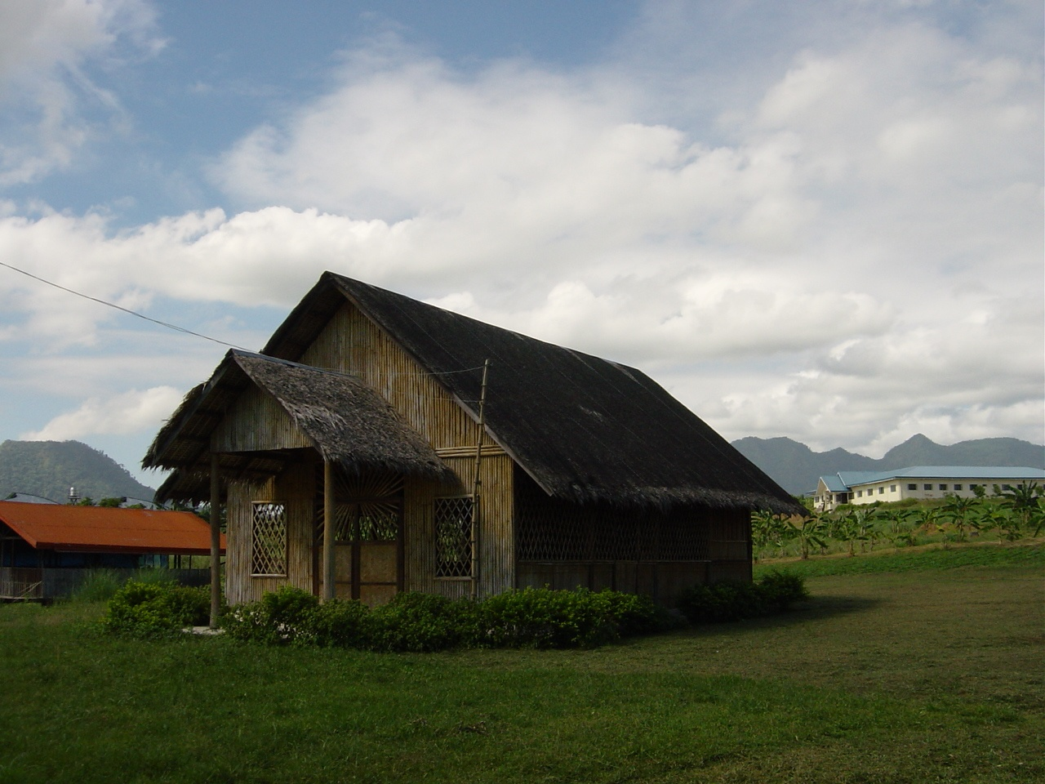
Thank You
World Canaan Movement
www.wcm.or.kr

