Slide 1

Life Toward Canaan
Canaan Farmers Training Center Medan, Indonesia

Slide 2
For any building, the foundation is critical.
It must be deep enough and solid enough to withstand the weight of building and other stresses.
Lives are like building, and the quality of each one’s foundation will determine the quality of the whole.
Matthew 7:24-27 “Therefore everyone who hears these words of mine and puts them into practice is like a wise man who built his house on the rock.
The rain came down, the streams rose, and the winds blew and beat against that house; yet it did not fall, because it had its foundation on the rock.
But everyone who hears these words of mine and does not put them into practice is like a foolish man who built his house on sand.
The rain came down, the streams rose, and the winds blew and beat against that house, and it fell with a great crash."
Foundation
To practice the Word of God

Slide 3
How to live ? – Start from me
You must build your life's foundation on a rock.
Matthew 6:33 <But seek first his kingdom and his righteousness, and all these things will be given to you as well.>
We must apply and practice the Word of God, which is the foundation of life.
Promise and Covenant
Blessings
Elder Yong Ki Kim
“With the Bible in one hand and a hoe in the other”
Meaning – He practice the Word of God in his life
Life transformation starts with small things
Luke 13:19 <It is like a mustard seed, which a man took and planted in his garden. It grew and became a tree, and the birds of the air perched in its branches.>

Slide 4
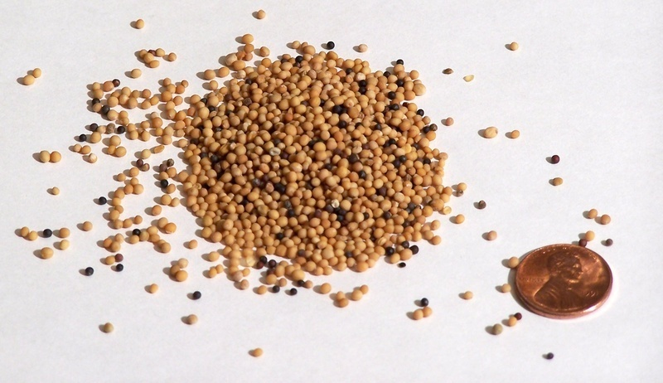

Small thing like mustard seed
Planting mustard seed
Tree
Prosperity
Mustard Seed
Mustard Tree

Slide 5
Small Thing (Mustard Seed)
You
Change
Your Family
Your Community
Your Nation
Three Things to Practice for the Success of Transformation
First, we must have three senses
Second, a revolution of our living attitudes
Third, know the elements to achieve the goal

Slide 6
1. Three senses of life
1) Sense of purpose
A man should have a definite sense of purpose
Where should we set our purpose?
Who give us purpose of in life?
God
Ephesians 1:11 <In him we were also chosen, having been predestined according to the plan of him who works out everything in conformity with the purpose of his will>
The Will of God
Our Life
Reason
Our Purpose
“We are not born accidently”
The work of those who set the final goal in this world ends with that, but the work of those who set the final goal in the eternal world continues forever

Slide 7
2) Sense of Responsibility
The meaning of responsibility:
- The fact of having an obligation to do something
- The state of having control over or care for someone
- The state of being capable of being trusted
As a Human Being
Responsibility
As a Family Member
As a Student
As a Employee
Right
As a Community Member
As a Citizen

Slide 8
Where the goal is set, there responsibility exists.
God has His purpose in creating man.
God created man to get His work done through men.
It is, therefore, the responsibility of a man to act according to His goal or creative purpose
Creation of Man
God
His Work
Through Man
Responsibility
Genesis 1:28 <Then God said, "Let us make man in our image, in our likeness, and let them rule over the fish of the sea and the birds of the air, over the livestock, over all the earth, and over all the creatures that move along the ground.“>

Slide 9
3) Sense of Mission
General Meaning of Mission
An important assignment carried out for political, religious, or commercial purposes, typically involving travel
The vocation or calling of a religious organization, especially a Christian one, to go out into the world and spread its faith
The meaning of mission in Canaan
A man’s faithful performance of his work
Work is divided into work with a sense of mission and work without a sense of mission
When work is done with the sense of mission, the result is bigger than that done without it.

Slide 10
When a man work, if he think it is God’s work, the result is great, but when he work, if he think it is human’s work, the result is less.
When a man work, if he think it is God’s work, the work is considered by him as his own work, but if he think simply just to follow the instruction of others is considered as a work he is forced to do.
If a man is pious to his parents by his own will, that is the mission; and if he does it simply because someone else does, then it is not the sense of mission..
Everything should be done with the sense of mission
Colossians 3:23 <Whatever you do, work at it with all your heart, as working for the Lord, not for men>

Slide 11
The life of Human Being
Sense of Purpose
Sense of Responsibility
Sense of Mission
Completion
(Finish, Accomplishment)
John 19:30 <When he had received the drink, Jesus said, "It is finished." With that, he bowed his head and gave up his spirit>
The life of Jesus Christ

Slide 12
2. Revolution of Living Attitude
Expose all bad customs, habits and tradition
physically and spiritually
Redressing
Selection of your 10 major bad customs, habits and tradition
You can check about redressing every month for six months

Slide 13
the foundation of life is inside the mind, and . . . . the rise and fall of a nation depends on the mind of the citizen. –Elder Yong Ki Kim –
Change myself first!
Change here first!
Change now first!
Change small thing first!
Change doable things first!
Change until the end!

Slide 14
Transforming Society
Transformation
Change myself first!
Nation
Family
Community
Individual
Transformation
Fruits

Slide 15
3. Six elements to achieve the goal
1) Vision
You must have a vision
A vision is a spiritual picture of the result you want to achieve
A vision is not a vague wish or hope, but it is a picture of the real outcome of real effort.
Vision
Clearly define a roadmap for the life
Should
Inspire to act and to think forwardly
Clear
Give practical guideline
Positive
Big Enough
Help to avoid detour or distraction

Slide 16
2) Self Confidence
Even if you have a vision, your vision will not come true if you don’t have self confidence
Meaning of Self Confidence
A feeling of trust in one's abilities, qualities, and judgment.
Positive Effects of Self Confidence
- Can have better performance: Instead of wasting energy and time worrying about your own shortcomings, you can focus your energy on your efforts
- The challenge trying new things: When you believe in yourself, you're more willing to try new things
- Resilience: Believe in yourself and you will strengthen your ability to overcome all the difficulties you face in life
- Healthy relationship with others

Slide 17
The Way to Build Up Self Confidence
- Don’t Compare Yourself to Others
If you are feeling envious of someone else’s life, remind yourself of your own strengths and successes
Everyone is running their own race of life and life is not a competition
- Be Generous with Yourself
Self-compassion is being kind to yourself when you make mistakes, fail, or experience setbacks
It makes you more emotionally flexible, better able to handle challenging emotions, and improves your relationships with others

Slide 18
- Practice Positive Self-Talk
Using optimistic self-talk can help you develop self-compassion, overcome self-doubt, and take on new challenges
- Face Your Fears
Some of your fears stem from a lack of self-confidence
Even if you're afraid of embarrassing and mess up, try it anyway.
You might learn that being a little anxious or making mistakes is not as bad as you thought
And each time you move forward, you gain more confidence in yourself, which will help you avoid taking risks that will eventually lead to significant negative consequences.

Slide 19
3) Must Know the Reason of Existence
All of you came to the earth not by incident or accident because you are only one in this world.
You came to the earth by the invisible great power
You must know that you are most valuable person in this earth
You are existing in the world to be loved
Romans 12:1 <Therefore, I urge you, brothers, in view of God's mercy, to offer your bodies as living sacrifices, holy and pleasing to God--this is your spiritual act of worship>
The reason of existence – Pleasing to God

Slide 20
4) Take Action
Even if you have a vision, confidence and know the reason of existence, if you don’t take action, it will be useless
It's easy to get excited about a vision, but often the vision doesn't translate into action
Turn Vision into Action
James 2:22 <You see that his faith and his actions were working together, and his faith was made complete by what he did.>
Not talk, but take action

Slide 21
5) Continuity
If you stop in the middle of starting, what you have been doing in the past will be useless
Revelation 2:10 <Do not be afraid of what you are about to suffer. I tell you, the devil will put some of you in prison to test you, and you will suffer persecution for ten days. Be faithful, even to the point of death, and I will give you the crown of life>
Once start, don’t stop and finish it
Success

Slide 22
6) Keep Moving Forward
Moving forward means not accepting it when life gets tough
It means that you are willing to keep going even when things are difficult.
Moving forward also means that you do not allow external circumstances to stop you from the pursuit of your goals.
Philippians 3:12 <Not that I have already obtained all this, or have already been made perfect, but I press on to take hold of that for which Christ Jesus took hold of me>
Keep moving forward until you reach goal

Slide 23
History
Beginning
Ending
Our Life
80 - 100 years
We must save a time in every second and live righteously not only for ourselves but also for neighbors, for the nation and for the world
For Christian
We must save a time in every second and live by The Will of God

Slide 24
All start from
Me
Our Society
My Family
Our Nation
My Community
Transform

Slide 25

Thank You
World Canaan Movement
www.wcm.or.kr

