Slide 1
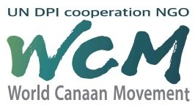
Christian Background Influencing Korea Development
Canaan Farmers Training Center Medan, Indonesia

Slide 2
Korea was the poorest country in the world in 1953
Income per Capita
US$91 in 1961
After 60 years
335 times Increase
Income per Capita
US$31,489 in 2020
How this was possible?
Can we learn from the Korean experience? YES!
Because of Christian background
To share our experience,
I am presenting Korea as the model of transformation influenced by Christianity

Slide 3
Long 50 years devastation by Japanese Forced Occupied Period and Korean War
Poverty
But next 50 years, Korea transformed
Devastation
Development
Poverty
Wealth
HOW is the big question?
Because of Christianity

Slide 4
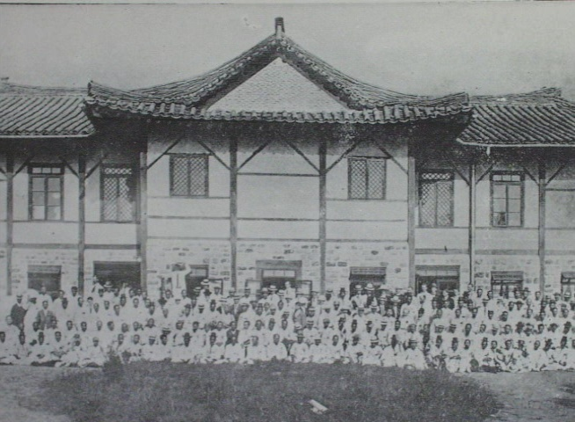
What was the foundation of this development?
Pyung-Yang Great Revival
From January 2 – 15 in 1907, Bible conference was held at ‘Jang-Dae-Hyun Church’ in Pyung-Yang.

Slide 5
1907 Pyung-Yang Great Revival
Until January 13 , 1907
No Grace & Cold
Elder Kil Sun Ju and 600 members
Great Revival by the power of Holy Spirit
Stay up to 2 o’clock in the morning on January 15 after noon prayer on January 14.
This was initiated by Elder Kil Sun Ju with his repentance
Elder Kil Sun Ju was asked to manage the property left by his friend when he died.
He made U$100 his own of that property. He shouted during prayer.
‘I am a thief who cheated on God and cheated on my friend and his wife.
I will return the money to his wife early tomorrow.’
At this time, all the congregation began to repent
Repentance

Slide 6
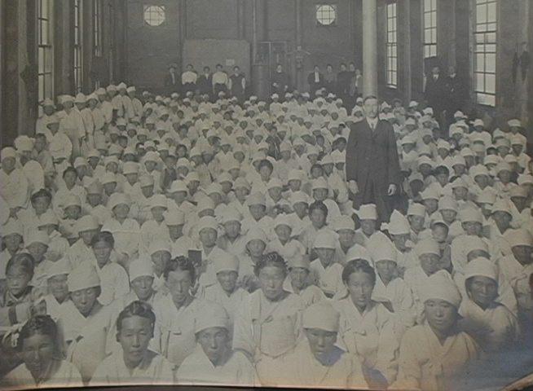
1907 Pyung-Yang Great Revival
January 14 – 15, 1907 at ‘Jang-Dae-Hyun Church’ in Pyung-Yang experienced a powerful move of the Holy Spirit.

Slide 7
People were consumed with a spirit of intense prayer of repentance and it was continued through out the bible conference at Jang-Dae-Hyun Church.
This Great Revival eventually spread onto the whole nation.
The fire-lit like revival brought experience of God to people having them to carry the power of Gospel being the witness of Christ harvesting fruits of Gospel nation.
But we must remember how the Jang Dae Hyun Church had a Great Revival at that time
It was started from one young missionary from England

Slide 8
In 1866, Robert Thomas executed at age 27
By Soldier Chun Kwon Park
Distribute Bible to Chi Ryang Choi
Give to Young Sik Park
Young Sik Park received Bible and used it as wallpaper in his house
Young Sik Park and Chun Kwon Park became Christian
This house became the Nuldari Church
Jang Dae Hyun Church

Slide 9
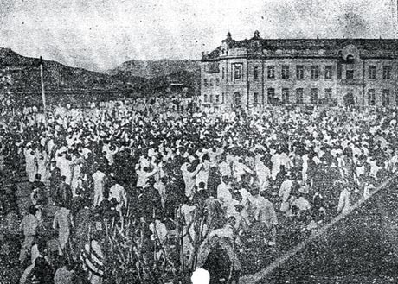
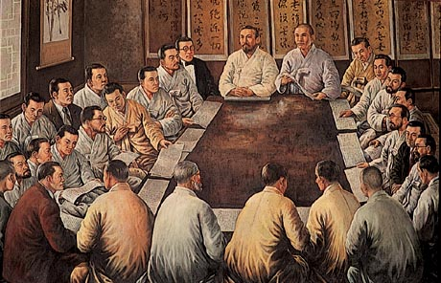
The Great Revival
One Million Saving Souls
The spread of the Gospel to the nation became the power to equip the Korean people to endure severe and inhumane oppression from the Japanese during the colonial period
Independent Movement Rising – Many Christians participate
March 1st Movement (March 1, 1919)
The March First Proclamation of Korean Independence
By 33 Representative
16 Christians

Slide 10
Video: Revival Pyung Yang 1907

Slide 11
There were many fruits of Christianity that influenced the development of Korea, but I am presenting two fruits of Christianity both of which became foundation of Korean development

Slide 12
First Fruit
Dr. Syngman Rhee, the first president of the Republic of Korea
Lineage of King of Joseon Dynasty
In prison due to resistance to Japan in 1899, age 24years old
Became Christian in 1899
He was life sentenced but he was pardoned after 5 years and 7 months.
When he was in prison, he wrote ‘The Spirit of Independence’ and many other articles including the New English-Korean Dictionary.
Exiled to USA by help of American Missionary
He got master degree from Harvard and Ph.D. from Princeton
Dedicated his life for the independence movement of Korea
not only inside Korea but also in abroad
Became the first president in 1948

Slide 13
During Presidency 1948 - 1960
Governed the nation based on the Bible
“With the spirit that all men were created equal”
Human & Physical Capital Accumulation
Foundation of Development of Korea
Land Reform
Education Policy
A form of confiscation at a cost and distribution at a cost
Purpose: - Modernization of rural society through the improvement of the anti feudal social structure in rural areas.
- Conversion of land capital of landlords into industrial capital or conversion of landlords into capitalists.
The Education Act in 1949
6-year Compulsory Education Plan of Elementary School June 1950.
Year 1959 Result – The rate of enrollment became 96% of all school-aged children

Slide 14
Second Fruit
Elder Yong Ki Kim
Started the Farmers Movement in 1931 and established the Bongan Ideal Village
A peaceful independent movement
Elder Kim founded Canaan Farmers School in 1962
Its purpose was to transform the mindset of the people with the PIONEERING SPIRIT
Bible
Saemul Undong or New Village Movement
Work, Service & Sacrifice
Development of Korea

Slide 15
Summary
Plan of Salvation
God
Korea
Sending Missionaries
Martyr (Robert Thomas in 1866)
The Great Revival
Spiritual Strength and wisdom for the Christians
Lead independence movement during Japanese occupation
Prosperity
Fruits of Christianity

Slide 16
God is always at His work to this day.
God who worked on the development of Korea wants to work through ‘the World Canaan Movement’ today as well.
World Canaan Movement
To help the development of countries and individuals that are suffering from poverty and oppression
Spread Gospel

Slide 17
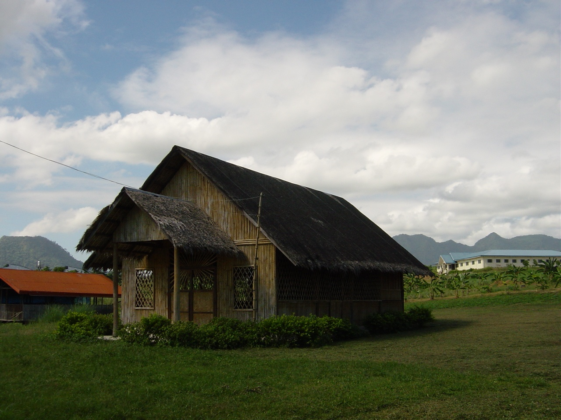
Thank You
World Canaan Movement
Canaan Farmers Training Center Philippines
www.wcm.or.kr
kwansoo46@yahoo.com

