Slide 1
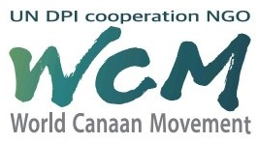
Community Development
Canaan Farmers Training Center Medan, Indonesia

Slide 2
1. Preface
Definition of Community Development
A process where community members come together to take collective action and generate solutions to common problems - United Nations -
Definition of Community Development by Canaan
A process for sustainable improvement of the quality of life among community members
Sustainability
The purpose of Community Development is to eradicate poverty and improve the quality of life sustainably

Slide 3
2. Paradigm Shift of Community Development
Project - Centered Project
Beneficiary - Centered Project
Transformation
With a Strong Will

Slide 4
Traditional Community Development
Beneficiary
Fund
Exhibition oriented project
&
Success of project itself
People
Project
Technology
Actual Beneficiary
Consultant, Supplier of facilities and technology, Principal of project
We can find out many times that those beneficiary who should receive benefit from the project were not able to receive it and it was impossible for them to have a sustainable growth.

Slide 5
New Community Development Model
Reproduction
Fund
Project
Beneficiary
People
Beneficiary - Oriented Project
Technology
Transformation of Mindset
Actual Beneficiary
Beneficiary
Sustainable growth,
Eradication poverty and improve the quality of life

Slide 6
3. Canaan Community Development
What do you need ?
Or
What do you have ?

Slide 7
Community development of Canaan is community driven development
Community Driven Development
Definition: A development initiative that provides control of the development process, resources and decision-making authority directly to community
Control of the development process
Community groups
Resources and decision-making authority
The World Bank recognizes that CDD approaches and actions are important elements of an effective poverty-reduction and sustainable development strategy

Slide 8
Video
CDD World Bank

Slide 9
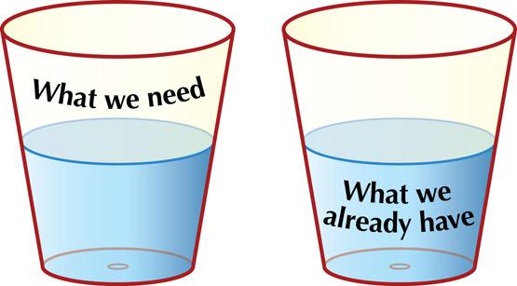
From DCBA Model to ABCD Model
Traditional model of community development was Deficiency of Community-Base Approach or Problem-Oriented Approach.
DCBA focuses on the community's needs, deficiencies and problems
Asset Based Community Development or ABCD is a method of community development that builds on the assets and strengths of a community
ABCD is a bottom-up way of working with communities that focuses on community strengths and assets rather than on deficits and problems
What do you need?
What do you have?
Is the glass half empty or half full?
ABCD focuses on the half-full glass.
Communities have many strengths, capabilities and assets
Communities are deficient and have many needs

Slide 10
Community Driven Development
Community Development, Aid
Community A
Reproduction
Transformation of Mindset
Indigenous
Concept
Community A
Pioneering Spirit
Increasing Asset &
Self Sustainable Community
Entrepreneurship

Slide 11
What is the meaning of ‘Indigenous Concept’ ?
To help them to stand for themselves and the development shall not be controlled by developing agency or social worker
Community Driven Development
Community Development
Introduction
Indigenous System, material & Procedure
Developing Agency
NGO
Participation
Helper & Guider
Member of Community
Can establish indigenous self-sustaining community

Slide 12
Accelerating Economic Growth
(Developed Country and Developing Country)
Promoting Capital Formation
&
Create Wealth
Hope
&
Dream
Of
Individual
Entrepreneurship
Reduction of Unemployment & Poverty
Pathway to Prosper

Slide 13
Strategies and direction of World Canaan Movement to develop rural community
Training
Transformation of Mindset
Community Development
Indigenous Concept
Development of simple and basic farm technology
Cooperate with local government
Cooperate with other institution
Eradicate Poverty & Improve the quality of life

