Slide 1

The Charter of the People of Canaan
Canaan Farmers Training Center Medan, Indonesia

Slide 2
Who are the People of Canaan ?
Genesis 12:1-2 <The LORD had said to Abram, "Leave your country, your people and your father's household and go to the land I will show you.
“I will make you into a great nation and I will bless you; I will make your name great, and you will be a blessing>
12:5 <He took his wife Sarai, his nephew Lot, all the possessions they had accumulated and the people they had acquired in Haran, and they set out for the land of Canaan, and they arrived there.>
God called Abram
The Selected People
God blessed Abram
The Blessed People
Arrived Canaan
The People of God
As the people of Canaan, they need to observe this charter

Slide 3
Work at least four hours for each meal
2 Thessalonians 3:10 <For even when we were with you, we gave you this rule: "If a man will not work, he shall not eat.“>
Exodus 20:9 “Six days you shall labor and do all your work”
Why not 8 hours a day but 12 hours a day?
To escape from poverty & To have better life
If we work 8 hours a day like the people of developed country, we cannot catch up with them

Slide 4
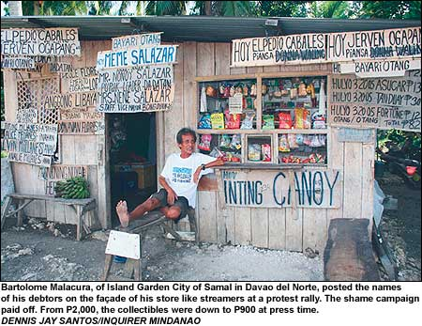
No earning, no spending
Debt Accumulation
Spend w/o earning
Depend on Others
Proverbs 21:20 In the house of the wise are stores of choice food and oil, but a foolish man devours all he has.
Balance of Income and Expense
Example: Record all Income and Expense

Slide 5
3. Do not be forced to live poorly, but force yourself to live well
Poverty is not fate
Challenge their life
God provided everything what man need to live in this earth
Pick & Utilize
Everything in the earth
Man
Through Work
Force to live poorly means they don’t work even if they can.
Forced to live well means that we have to challenge ourselves to live well, even though various circumstances make it difficult for us to live well.
Exodus 20:9 “Six days you shall labor and do all your work”

Slide 6
Be a citizen who knows the right way of using materials, power, knowledge and technology
Misusing of
Material
Loss & Make life difficult
Oppress the people & No protection
Power
Knowledge & Technology
Destroy the society
A good knife is used to cook delicious food when given to a housewife, but if given to a robber, it hurts people
Proverbs 14:31 “He who oppresses the poor shows contempt for their Maker, but whoever is kind to the needy honors God.”

Slide 7
Be free from material and mental indebtedness
When person has material and mental indebtedness, not only his body but also his spirit is not free
Romans 13:8 “Let no debt remain outstanding, except the continuing debt to love one another, for he who loves his fellowman has fulfilled the law.”
Proverbs 22:7 “The rich rule over the poor, and the borrower is servant to the lender.”
Material Indebtedness
Poverty
Mental Indebtedness
Mental Colony
Instead, saving & Independent

Slide 8
Demonstrate the excellence of our people through our work, mind and action
A nation consists of each individual of the nation, and the future of a nation depends on the behavior of each individual citizen
Patriotism starts from self love and self respect, which lead us to love the nation.
How can you show the excellence of your people?
Find – Promotion – Demonstration
Ex) To make good quality of products. To show the good performance of work. Using good quality of attitudes.
The total combination of excellence of the individual becomes the national excellence

Slide 9
Make our mind attractive before we make our outward appearance beautiful
1 Peter 3-4 “Your beauty should not come from outward adornment, such as braided hair and the wearing of gold jewelry and fine clothes.
Instead, it should be that of your inner self, the unfading beauty of a gentle and quiet spirit, which is of great worth in God's sight.”
The making of the appearance beautiful may be accomplished by make-up, and the making of the mind attractive is a training of the personality..
The face made of cosmetics will not last long, but the beautiful mind last forever.
A man who has developed a beautiful mind is always seeking for the truth for himself.
The man who has made his appearance attractive is always seeking reputation.

Slide 10
1 Samuel 16: 7 <But the LORD said to Samuel, "Do not consider his appearance or his height, for I have rejected him. The LORD does not look at the things man looks at. Man looks at the outward appearance, but the LORD looks at the heart.“>
How can we make our mind attractive?
Have a pure & sincere heart
Can get wisdom from heaven
Talk with heart
Can get trust from others
Don’t lie and pretend
Will gain everything

Slide 11
8. Do not conform to foreign fashion but rather support our people's sensitivity
This is principle for the proper advancement of culture.
Because if one copies just foreign trends, the original culture will be lost, resulting in the loss of the individual and the nation.
But we should not stick only to our original culture in order not to be behind while disregarding the sense of the age.
Therefore, the adjustment should be made according to the sense of the age..
Respect our own culture and support our people’s sensitivity while considering the sense of the age.

Slide 12
Economical Aspect
Using foreign brand
Outflow of money to abroad
No domestic investment
No job creation
Using domestic brand
New investment
Job creation
Buy Domestic Brand

Slide 13
Unite our family and neighbor first even before uniting our country as a whole
1 Timothy 3:4-5 <He must manage his own family well and see that his children obey him with proper respect
(If anyone does not know how to manage his own family, how can he take care of God's church?)
The cordial and consolidated relationship can not be created by force, but are made possible only by love.
Unification of family & neighbor
Unification of country

Slide 14
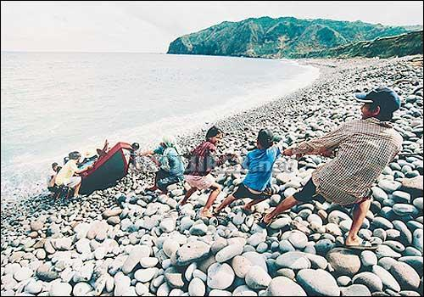
Unity
HANDS ON. The stone-studded steep incline makes it tough for children earning their keep by helping fishermen draw up boats to the shorelines of Barangay Valugan, Basco, Batanes. But everyone in this coastal town feels obliged to lend a helping hand as they believe that their survival depends on their working together as one community. INQUIRER 4/26/07

Slide 15
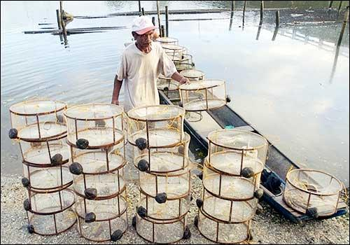
10. Do not be a man to be told what to do, but be a man who initiates his own work
Proverbs 6: 6-8 “Go to the ant, you sluggard; consider its ways and be wise!
It has no commander, no overseer or ruler,
yet it stores its provisions in summer and gathers its food at harvest.”
TRAPPINGS Romeo Istanislao, 67, unloads his shrimp traps after a day's work at a river that passes through San Isidro in Negros Occidental.
He earns about P350 ($7.21) a day, a respectable amount in the province where poverty is widespread even though the island is the sugar capital of the Philippines. AFP/JAY DIRECTO March 10, 2007
Passive
Activity
Grab opportunity & don’t lose it

Slide 16
11. If our body is deeply asleep, our materials will be stolen; If the nation is deeply asleep the sovereignty will be stolen; If our spirit is deeply asleep, our soul will be ruined
Loss of Material
& Health
Poverty &
Death
Body Asleep
Loss of Territory &
Sovereignty
Physical or Mental
Colony
Nation Asleep
Ruin of Soul
Eternal Punishment
Spirit Asleep
Always Wake Up

Slide 17
Keep God, the Creator, as Father of our whole nation
Matthew 6:33 <But seek first his kingdom and his righteousness, and all these things will be given to you as well.>

Slide 18
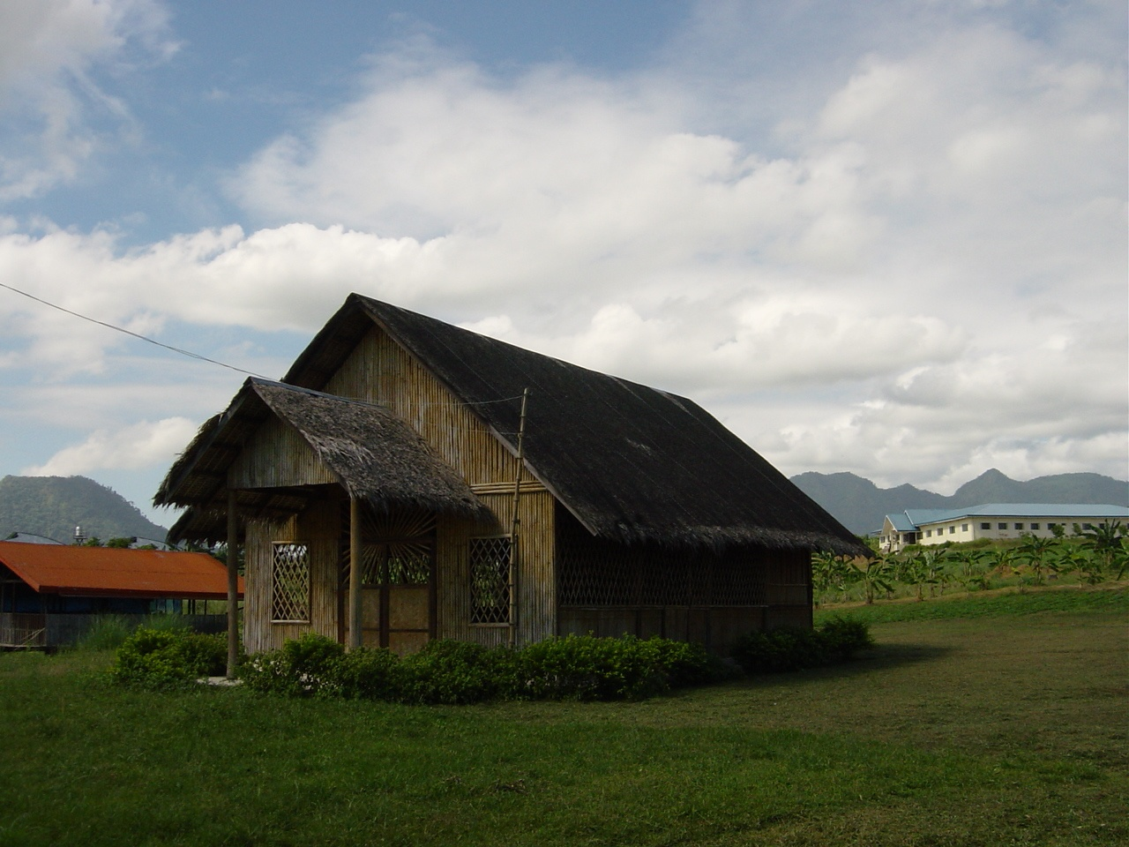
Thank You
World Canaan Movement
www.wcm.or.kr

