Slide 1

Pioneering Spirit
Canaan Farmers Training Center Medan, Indonesia

Slide 2
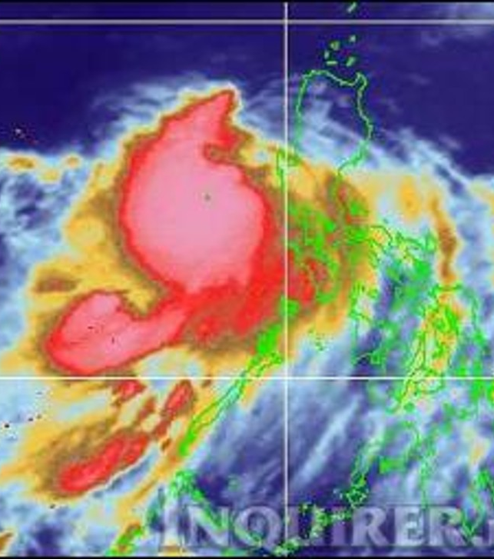
Typhoon
Life is not smooth and
encountering
big trouble like typhoon

Slide 3
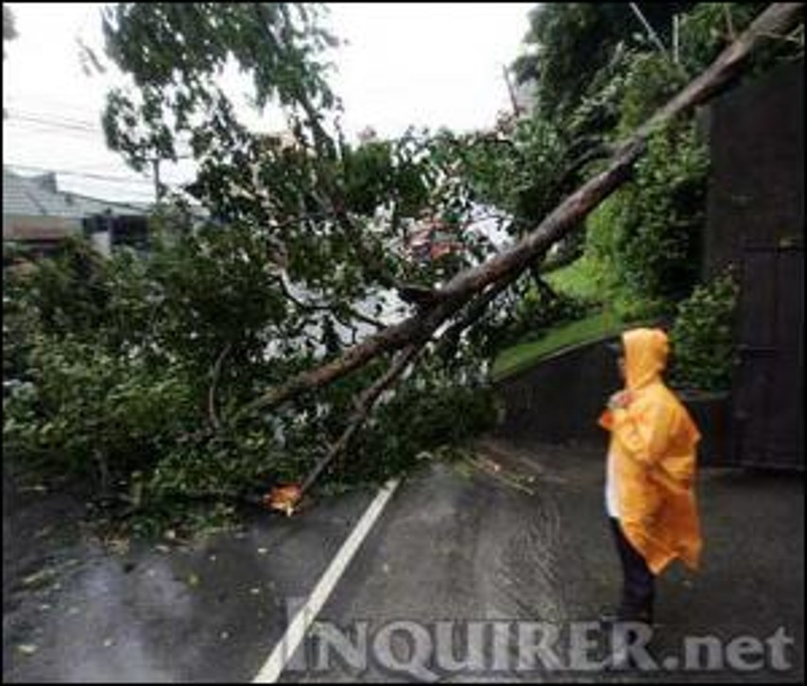
Typhoon
Sometimes life is falling down like broken trees

Slide 4
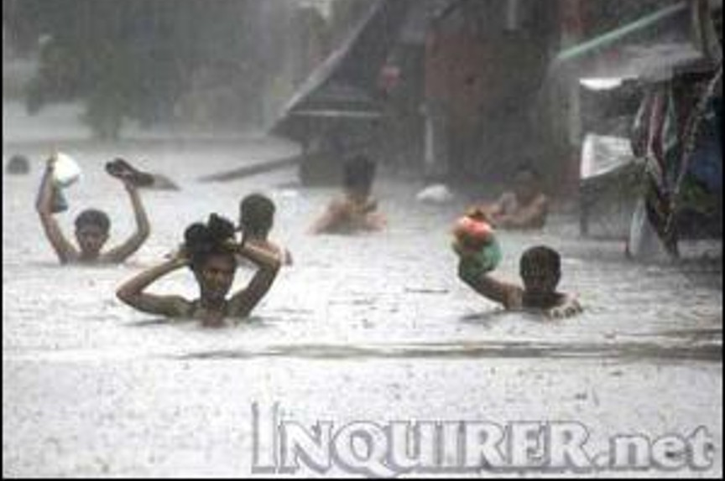
Typhoon
It feels like everything is submerging

Slide 5
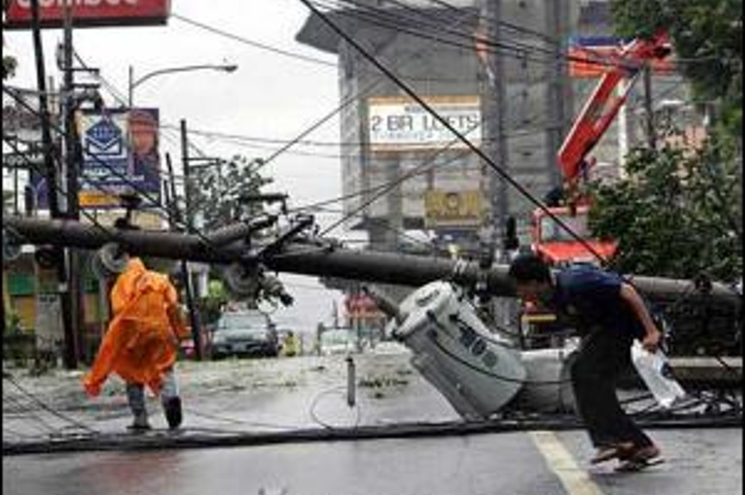
Typhoon
Mind goes blank as if there's a power outage

Slide 6
To overcome the difficulties in our life , we need to have a strong spirit
Pioneering Spirit
What is the meaning of a pioneer ?
A person who begins or helps develop something new and prepares the way for others to follow.
How does Canaan define a pioneer ?
A person who create a new life
What is the meaning of pioneering spirit ?
The spirit necessary to create a new life
Life on this earth is finite and short
How can we live this one-time, finite life?
We must constantly create a new life on this earth with creative thoughts and actions

Slide 7
Main principle of the Pioneering Spirit is Spiritual Transformation and revolution of the living attitude
Spiritual Transformation means to transform the mindset of people by the Pioneering Spirit
The revolution of living attitude means to apply the pioneering spirit what they learn as knowledge to their life
Transformation of Family & Community
Spiritual Transformation
Transformation of Individual
Revolution of Living Attitude
Transformation of Society, Nation & World
Transformation of Mindset
Pioneering Spirit

Slide 8
This pioneering spirit, the three fundamental spirits necessary to create a new life, are work(life to work), service(life to serve), and sacrifice(life to sacrifice).

Slide 9
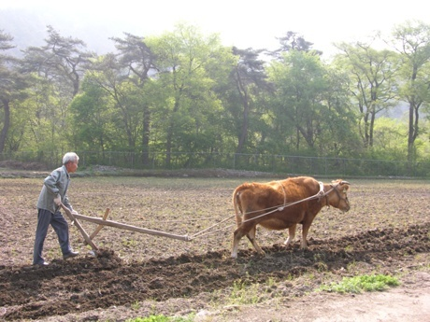
1. Work (Life to work)
Work: Activity involving mental or physical effort done in order to achieve a purpose or result.
Why do humans have to work?
What is the difference between humans and animals in general?
First, In general, humans work and animals do not
Don’t animals work?
Cow is working
Cows work because humans make it plow
If human beings work simply under the instruction of others, they will be no different from animals
What is the secret not to be an animal when working ?
After receiving instructions and before starting work, if you think that it is your own work and start work, it becomes your work and you become a human being
When you think it is your own work and do it, it's not only joy but it also increases the efficiency of your work.

Slide 10
Second, animals work to eat and humans eat to work.
If man was born to eat simply, his life would be meaningless
Daily Timetable
Free Time 4 hours
Sleeping Time
7 hours
What is my time in 24 hours a day?
12 hours, of which 8 hours are working hours.
We spend 2/3 of our life working
Working Time 8 hours
Meal Time 3 hours
Working Attitude
Commuting 2 hours
Happy Mind
Healthy and Fruitful Life
Taking Ownership

Slide 11
Taking Ownership
What is the meaning of taking ownership?
A mindset of leading an organization or work actively and autonomously with a sense of responsibility as a principal agent.
A mindset of leading any task with a sense of responsibility and doing one's best, as if it were one's own
It means to work as the owner of your own life, not as the owner of the organization
Various positive effects on organizations and individuals
Build trust among members
Improvement of organizational and job commitment
Proactive work processing and increased creativity
Taking Ownership
Improved performance and productivity
Pathway to Prosperity

Slide 12
Reasons to work
1) To obtain happiness and prosperity
Work can lead to a happy and prosperous life
If you work,
First, provide spiritual and physical health
Second, create wealth
Third, create cooperation after making a relationship
Fourth, become independent
Fifth, make peace
Work is a basic human life, and one can achieve happiness and prosperity through work

Slide 13
2) Not to be fall in poverty
Proverbs <How long will you lie there, you sluggard? When will you get up from your sleep?
A little sleep, a little slumber, a little folding of the hands to rest,
and poverty will come on you like a bandit and scarcity like an armed man.>
3) To be a model without burdening others
If you live without work, you will be forced to get help from others for a living
Also, if you do not work and depend on others, you cannot be a model to others
Canaan Table Manner
If you don’t like to work, do not eat

Slide 14
Diligence and self-help, which are important spirits in the idea of ​​work
Diligence(Work hard): The realization of efforts to make the most of what is available
The spirit of diligence contains
- Thinking and working reasonably
- Planning carefully and practicing consistently
- Getting thoughts broadly by putting eyes afar
- Doing action firmly
Self-help is the will to independently define one's fate based on personal efforts, setting the basis of self-control and independence
The spirit of self-hep contains
- Doing my work by me
- Realizing that my fate and future depends on me
- Doing the best in my efforts
Work for the right thing and get paid reasonably for it’s work

Slide 15
2. Service (Life to Serve)
General meaning of service: ‘Serving others by the will of others’ ‘Dedicated work for the country, society and others’
In the pioneering Spirit, what kind of life is life to serve?
Life to serve does not end with simply helping, but it can be said that true service is to help neighbors gain hope and continue to pioneer their own lives sustainably through service.
General Service
Canaan Service
Giving or Providing Necessities
Life Cultivation for Sustainable Development

Slide 16

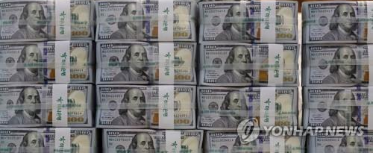
Service of Canaan
Living for others
Why do we need to serve others?
Humans cannot live alone in this earth
If humans live alone on this uninhabited island, will their worth be recognized ?
The reason I exist is because my neighbors exist.
Humans
Communal Existence
My life is important, but the life of my neighbor is also important.
Helping
True Service
Give Hope
Helping them to pioneer their lives

Slide 17
Three important elements of a life of service
First, humble mind
Second, preparation of service always
Third, complete service
Every individual
wants to be served
and not want to serve
World Community
Husband
Serve
Wife
Parent
Children
Teacher
Student
In all the community, if they serve each other
Achieve the peace in all the community

Slide 18
3. Sacrifice(Life to sacrifice)
Giving or throwing away one's life, property, interests, etc. without taking care of it in order to achieve a certain purpose
True Sacrifice
Love
Sacrifice is impossible without love
This sacrifice is the highest expression of the love for mankind that can be given
And true love originate from self-sacrifice

Slide 19
Practice of Sacrifice: To give up most valuable things for the sake of others
How can we apply these sacrifices in our daily lives?
First, to live righteously and do not compromise with unrighteousness in the world - Sacrifice of unrighteous wealth and honor
Second, respecting others from the heart – Sacrifice of authority and seniority
Third, know how to deny oneself – Sacrifice of pride
Fourth, not to live for own greed but live for others – Sacrifice of greed

Slide 20
Work
I am the first
Pioneering Spirit
Service
Sacrifice
Work
Love Soil
Live for ourselves
Service
Love Neighbor
Live together
Sacrifice
Love God
Live righteously

Slide 21
If I work diligently first, I can keep pace and live with companion
If I serve my neighbors first with my heart, I can raise up those who are struggling and in trouble, and live along with them
If I first give up what I have for others, others will live because of me, and everyone can walk together
Pioneering Spirit
Practice in Life
Transformation of Individual
Transformation of the Society

