Slide 1

Pioneering Spirit
Canaan Farmers Training Center Medan, Indonesia

Slide 2
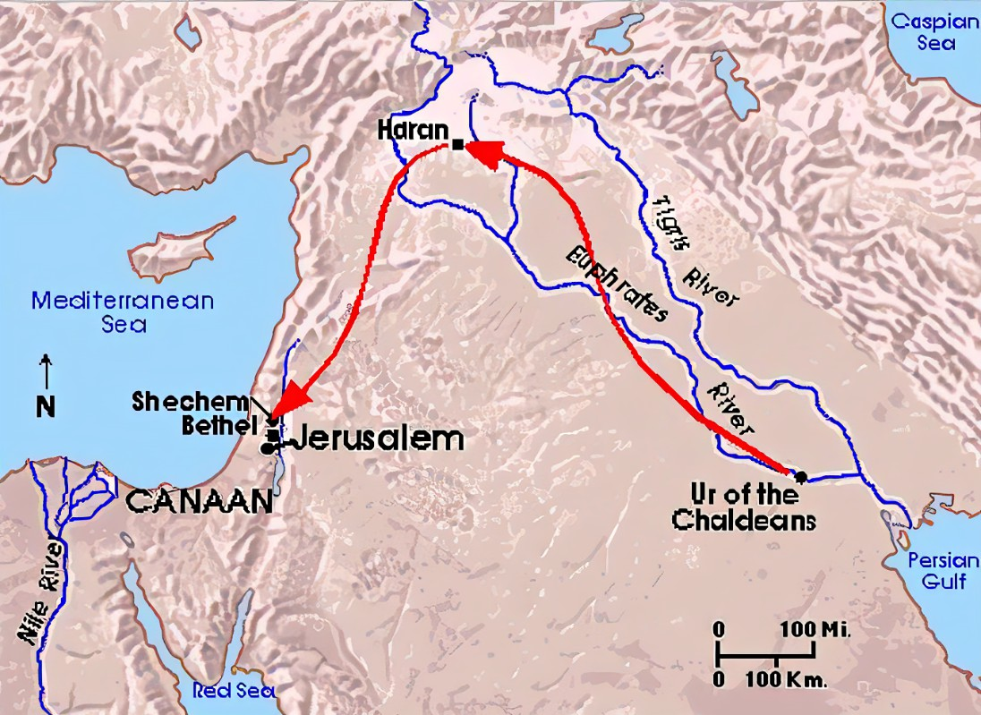
The Root of Pioneering Spirit is Canaan Spirit
What is the background and meaning of Canaan?
Acts 7: 2-4 To this he replied: "Brothers and fathers, listen to me! The God of glory appeared to our father Abraham while he was still in Mesopotamia, before he lived in Haran.
‘Leave your country and your people,' God said, 'and go to the land I will show you.’
“So he left the land of the Chaldeans and settled in Haran. After the death of his father, God sent him to this land where you are now living.
God Called Abraham from Ur of the Chaldeans
Center of civilization area where idols were worshiped between the Tigris and Euphrates rivers

Slide 3
Abraham, who was called, went to the land indicated by God after stayed in Haran.
Genesis 12: 1-5 <The LORD had said to Abram, "Leave your country, your people and your father's household and go to the land I will show you.
“I will make you into a great nation and I will bless you; I will make your name great, and you will be a blessing,
I will bless those who bless you, and whoever curses you I will curse; and all peoples on earth will be blessed through you.“
So Abram left, as the LORD had told him; and Lot went with him. Abram was seventy-five years old when he set out from Haran.
He took his wife Sarai, his nephew Lot, all the possessions they had accumulated and the people they had acquired in Haran, and they set out for the land of Canaan, and they arrived there.>
Migration
Canaan
Egypt
Training at Desert for 40 Years
400 Years
Starting of Israel

Slide 4
What is the meaning of Canaan in New Testament derived from Old Testament?
Jesus Christ
God
Man
Kingdom of God
Salvation
Galatians 3: 16 The promises were spoken to Abraham and to his seed. The Scripture does not say "and to seeds," meaning many people, but "and to your seed," meaning one person, who is Christ.
Galatians 3: 28-29 There is neither Jew nor Greek, slave nor free, male nor female, for you are all one in Christ Jesus.
If you belong to Christ, then you are Abraham's seed, and heirs according to the promise.
Just as God called Abraham and led him to Canaan, the land of promise, those who believe in Jesus Christ can also enter the kingdom of God through the promise through Jesus Christ.
Canaan is the place of promise and the place of blessing

Slide 5
Christians who have entered Canaan, or the kingdom of God, must imitate the life of Jesus Christ with a Christian worldview, and live with the Christian Spirit.
Christian Spirit
Canaan Spirit
Pioneering Spirit
Work
Service
Sacrifice
The Life of Jesus Christ
John 5:17 <Jesus said to them, "My Father is always at his work to this very day, and I, too, am working.“>
Mark 10:45 <For even the Son of Man did not come to be served, but to serve, and to give his life as a ransom for many.“>
Ephesians 5:2 <And live a life of love, just as Christ loved us and gave himself up for us as a fragrant offering and sacrifice to God.>
The Life of Christian

Slide 6
It is the responsibility and work for the Christians to lead the people in the world to enter the Kingdom of God with Canaan Spirit.
The meaning of Canaan
Land of Hope and Promise
Land of Milk and Honey
Land of Recovery and Blessing
Land of our Lord Supervise

Slide 7
Main principle of the Canaan Spirit (Pioneering Spirit) is Spiritual Transformation and revolution of the living attitude
Spiritual Transformation means to transform the mindset of people by the Pioneering Spirit
The revolution of living attitude means to apply the pioneering spirit what they learn as knowledge to their life
Transformation of Family & Community
Spiritual Transformation
Transformation of Individual
Revolution of Living Attitude
Transformation of Society, Nation & World
Transformation of Mindset
Pioneering Spirit

Slide 8
What is the meaning of a pioneer ?
A person who begins or helps develop something new and prepares the way for others to follow.
How does Canaan define a pioneer ?
A person who create a new life
What is the meaning of pioneering spirit ?
The spirit necessary to create a new life
Life on this earth is finite and short
How can we live this one-time, finite life?
We must constantly create a new life on this earth with creative thoughts and actions

Slide 9
This pioneering spirit, the three fundamental spirits necessary to create a new life, are work(life to work), service(life to serve), and sacrifice(life to sacrifice).

Slide 10
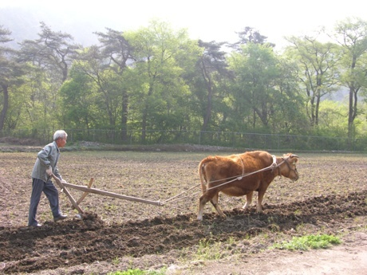
1. Work (Life to work)
Work: Activity involving mental or physical effort done in order to achieve a purpose or result.
Why do humans have to work?
What is the difference between humans and animals in general?
First, In general, humans work and animals do not
Don’t animals work?
Cow is working
Cows work because humans make it plow
If human beings work simply under the instruction of others, they will be no different from animals
What is the secret not to be an animal when working ?
After receiving instructions and before starting work, if you think that it is your own work and start work, it becomes your work and you become a human being
When you think it is your own work and do it, it's not only joy but it also increases the efficiency of your work.

Slide 11
Second, animals work to eat and humans eat to work.
If man was born to eat simply, his life would be meaningless
Daily Timetable
Free Time 4 hours
Sleeping Time
7 hours
What is my time in 24 hours a day?
12 hours, of which 8 hours are working hours.
We spend 2/3 of our life working
Working Time 8 hours
Meal Time 3 hours
Working Attitude
Commuting 2 hours
Happy Mind
Healthy and Fruitful Life
Taking Ownership

Slide 12
Taking Ownership
What is the meaning of taking ownership?
A mindset of leading an organization or work actively and autonomously with a sense of responsibility as a principal agent.
A mindset of leading any task with a sense of responsibility and doing one's best, as if it were one's own
It means to work as the owner of your own life, not as the owner of the organization
Various positive effects on organizations and individuals
Build trust among members
Improvement of organizational and job commitment
Proactive work processing and increased creativity
Taking Ownership
Improved performance and productivity
Pathway to Prosperity

Slide 13
As Christians, taking of ownership must be changed to a Biblical Stewardship mindset.
Taking Ownership
Biblical Stewardship
Work for organization as owner
Work for God as caretaker
Foundation of stewardship in the Bible
- Creation and Ownership of God
Genesis 1:1 In the beginning God created the heavens and the earth
Psalm 24:1 The earth is the LORD's, and everything in it, the world, and all who live in it;
- Responsibility of Human
Genesis 1:28. Subdue the earth and rule over all creation.
God entrusted to humans to manage and care for creation with responsibility.
- Mission and Accountability
Mission: Man’s faithful performance
Romans 14:12 So then, each of us will give an account of himself to God
Colossians 3:23 Whatever you do, work at it with all your heart, as working for the Lord, not for men,

Slide 14
Reasons to work
1) God’s command
Genesis 1:27-28 <So God created man in his own image, in the image of God he created him; male and female he created them. God blessed them and said to them, "Be fruitful and increase in number; fill the earth and subdue it. Rule over the fish of the sea and the birds of the air and over every living creature that moves on the ground.“>
Subdue it, Rule over
Work
Genesis 2:15 <The LORD God took the man and put him in the Garden of Eden to work it and take care of it.>

Slide 15
2) To obtain happiness and prosperity
Work can lead to a happy and prosperous life
Psalms 128:2 <You will eat the fruit of your labor; blessings and prosperity will be yours.>
If you work,
First, provide spiritual and physical health
Second, create wealth
Third, create cooperation after making a relationship
Fourth, become independent
Fifth, make peace
Work is a basic human life, and one can achieve happiness and prosperity through work

Slide 16
3) Not to be fall in poverty
Proverbs 6:9-11 <How long will you lie there, you sluggard? When will you get up from your sleep?
A little sleep, a little slumber, a little folding of the hands to rest,
and poverty will come on you like a bandit and scarcity like an armed man.>
4) To be a model without burdening others
2 Thessalonians 3:8-10 <nor did we eat anyone's food without paying for it. On the contrary, we worked night and day, laboring and toiling so that we would not be a burden to any of you. We did this, not because we do not have the right to such help, but in order to make ourselves a model for you to follow. For even when we were with you, we gave you this rule: "If a man will not work, he shall not eat.“>
If you live without work, you will be forced to get help from others for a living
Also, if you do not work and depend on others, you cannot be a model to others
Canaan Table Manner
If you don’t like to work, do not eat

Slide 17
Diligence and self-help, which are important spirits in the idea of ​​work
Diligence – Work hard
The realization of efforts to make the most of what is available
The spirit of diligence contains
- The spirit of thinking and working reasonably
- The spirit of planning carefully and practicing consistently
- The spirit of getting thoughts broadly by putting eyes afar
- The spirit of doing action firmly

Slide 18
Self-help is the will to independently define one's fate based on personal efforts, setting the basis of self-control and independence
The spirit of self-hep contains
- The spirit of doing my work by me
Realizing that my fate and future depends on me
- Doing the best in my efforts
Work for the right thing and get paid reasonably for it’s work

Slide 19
2. Service (Life to Serve)
General meaning of service: ‘Serving others by the will of others’ ‘Dedicated work for the country, society and others’
In the pioneering Spirit, what kind of life is life to serve?
Life to serve does not end with simply helping, but it can be said that true service is to help neighbors gain hope and continue to pioneer their own lives sustainably through service.
Matthew 20:27-28 <and whoever wants to be first must be your slave-- just as the Son of Man did not come to be served, but to serve, and to give his life as a ransom for many.>
Jesus came to the earth to serve
Christian has to serve

Slide 20

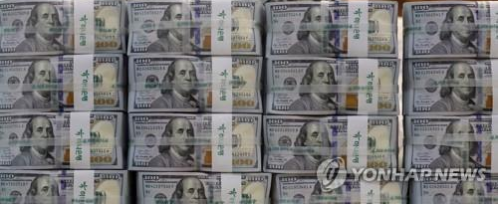
Service of Canaan
Living for others
Why do we need to serve others?
Humans cannot live alone in this earth
If humans live alone on this uninhabited island, will their worth be recognized ?
The reason I exist is because my neighbors exist.
Humans
Communal Existence
Therefore my life is important but the life of my neighbor is also important.
Helping
True Service
Give Hope
Helping them to pioneer their lives

Slide 21
Three important elements of a life of service
First, humble mind
Second, preparation of service always
Third, complete service
John 13:4-5 <so he got up from the meal, took off his outer clothing, and wrapped a towel around his waist. After that, he poured water into a basin and began to wash his disciples' feet, drying them with the towel that was wrapped around him.>
Took off outer clothing
Humbleness
Wrapped a towel around his waist
Preparation
Wash disciple’s feet and dry
Complete serving

Slide 22
Community
Company
Family
Every individual
wants to be served
and not to serve
Society
Church
School
Nation
World
If Christians follow the Jesus Christ,
Husbands shall serve wives, wives shall serve husbands.
Parents shall serve children, children shall serve parents
Teachers shall serve students, students shall serve teachers
In the church, society and nation, everybody shall serve each other
Achieve the peace in all the community

Slide 23
3. Sacrifice(Life to sacrifice)
Giving or throwing away one's life, property, interests, etc. without taking care of it in order to achieve a certain purpose
True Sacrifice
Love
Sacrifice is impossible without love
Ephesians 5:2 < and live a life of love, just as Christ loved us and gave himself up for us as a fragrant offering and sacrifice to God.>
This sacrifice is the highest expression of the love for mankind that can be given
Sacrifice is more valuable than service as an instrument to teach love
And true love originate from self-sacrifice

Slide 24
John 12:24-25 <I tell you the truth, unless a kernel of wheat falls to the ground and dies, it remains only a single seed. But if it dies, it produces many seeds. The man who loves his life will lose it, while the man who hates his life in this world will keep it for eternal life.>
Sacrifice of Jesus
Save the world
Sacrifice myself
Save the lost soul
Keep our life for eternal life

Slide 25
Practice of Sacrifice: To give up most valuable things for the sake of others
How can we apply these sacrifices in our daily lives?
First, to live righteously and do not compromise with unrighteousness in the world - Sacrifice of unrighteous wealth and honor
Second, respecting others from the heart – Sacrifice of authority and seniority
Third, know how to deny oneself – Sacrifice of pride
Fourth, not to live for own greed but live for others – Sacrifice of greed

Slide 26
Work
I am the first
Pioneering Spirit
Service
Sacrifice
Work
Love Soil
Live for ourselves
Service
Love Neighbor
Live together
Sacrifice
Love God
Live righteously

Slide 27
If I work diligently first, I can keep pace and live with companion
If I serve my neighbors first with my heart, I can raise up those who are struggling and in trouble, and live along with them
If I first give up what I have for others, others will live because of me, and everyone can walk together
Pioneering Spirit
Practice in Life
Transformation of the World

Slide 28

Thank You
World Canaan Movement
www.wcm.or.kr

