Slide 1

Canaan Strategies for
Transformation
Canaan Farmers Training Center Medan, Indonesia

Slide 2
Traditional Aid and Development Strategies
- To teach the technology
- To construct facilities necessary to community
- Provide all the basic needs
Developed the mindset of dependency.
Merely relying on aid from foreign countries or social workers
Problem of community in the developing area
Foreign aid or NGO
Support
Not self-supported
Not sustainable

Slide 3
Sustainable Development
To have a sustainable development and growth, it is important to know the mechanism of receiving help from other people or country
Two mechanism to help
Giving food and other necessities | Teaching how to cultivate
Immediate relief, improvement | Wait a long time with patience
Immediate result | No immediate result seen
Need to supply continually | Can stop after a certain period
Encourage dependence | Encourage independence
Disaster, War and Temporary relieve
Sustainable Development
To achieve sustainable development and growth in order to eradicate poverty, they need to learn how to cultivate their life

Slide 4
To have better and fruitful life
know how to cultivate the life
Cultivating life is like cultivating soil
Planting seed by farmer
Waste(Bad) Soil
Bad Harvest
Fertile(Good) Soil
Good Harvest
The first thing a farmer needs to do before sowing is to change the soil from barren land (soil) to fertile soil
Like farming, in order to cultivate our life, we must first convert first our idle(bad) mind to fertile(good) mind.
Physical & Spiritual
Waste Land
Physical & Spiritual
Fertile Land
Transformation of Mindset
What is needed to cultivate life is a transformation of mindset

Slide 5
Almost 45% of the population in the world lives in households where agricultural activities represent the main occupation of the head.
How can farmers make successful farming ?
Can eradicate poverty and improve the quality of life
Farming
Soil
Need good soil
Cultivation of soil or land
From passive to active
Cultivation of mind
From lazy to diligent
Transformation of
Mindset
From negative to positive
From dependent to independent
From hate to love

Slide 6
Every individual can improve the quality of their life
How can individual make successful result?
Livelihood
Or House Mangement
Can eradicate poverty and improve the quality of life
Human &
Material
Need good resources
Good management
From passive to active
Cultivation of mind
From lazy to diligent
From negative to positive
Transformation
of
Mindset
From dependent to independent
From hate to love

Slide 7
Physical and spiritual farming
Farming
Physical Farming
(Soil)
Spiritual Farming
(Mind)
Planting Seeds
Planting Thoughts
Good
Soil
Bad
Soil
Good
Mind
Bad
Mind
Good
Harvest
Bad
Harvest
Good
Behavior
Bad
Behavior
We need to have a fertile (good) land physically and spiritually through transformation of mindset

Slide 8
The Parable of the sower (Matthew 13: 3 – 23)
Fell along the path
Don’t Understand
Fell on rocky places with not much soil
Received with joy but no root and not last long
Fell among thorns
Hear the word but unfruitful because of worries and wealth
Fell on good soil
Received word and understand. Bear fruit yielding hundred times

Slide 9
Normally it is easy to give them something necessary, but it is very difficult to teach them how to cultivate their life.
What is more difficult ?
To give them mind-set of independence
What we need ?
Challenge and Reformation
Transformation of mindset
Education & Training
Pioneering Spirit

Slide 10
How can people be transformed ?
People can be transformed by the Christian spirit
Born Again
A man
Christian
New Creature
Same life as before
“Christians need transformation of their whole life”
“But transformation of their whole life is not complete unless they renew their mind”
Do not conform any longer to the pattern of this world, but be transformed by the renewing of your mind. Then you will be able to test and approve what God's will is--his good, pleasing and perfect will. – Romans 12:2 -

Slide 11
How can people transform their life practically ?
We need to practice the “True and Good Ways of Living” through training
Practicing ‘True and Good Ways of Living’ by Training
Transformation of Mindset
Transform the Life of Mankind
Physical & Spiritual Waste Land
Physical & Spiritual Fertile land
Pioneering Spirit
No Physical & Spiritual Poverty

Slide 12
What is the meaning of transformation?
“a marked change in nature, form, or appearance.”
Transformation Mindset is revolution of mindset
Mindset – the established set of attitudes
a habitual way of thinking
Transformation Mindset is to change a habitual way of thinking
Transformation of Mindset
Physical & Spiritual
Waste Land
Physical & Spiritual
Fertile Land
To transform our mindset,
Who am I now ?
Who was I before ?
Who will be I in the future ?

Slide 13
Transformation of Mindset
You can see yourself better
Be able to correct your old and unproductive mind
You can see your neighbors in a clear and better way
Establish good relationship
You can see the world from a better perspective
Doing something to help change the world

Slide 14
To cultivate our life in order to improve the quality of our life
Challenge & Reformation
Transformation of Mindset
New Vision and Dream
New Plan
New Project

Slide 15
Transformation of Mindset
Transformation of Behavior
Passive
Active
Negative
Positive
Dependent
Independent
Laziness
Diligence
Selfishness
Altruism
Greed
Satisfaction
Hate
Love
Cannot do
Can do

Slide 16
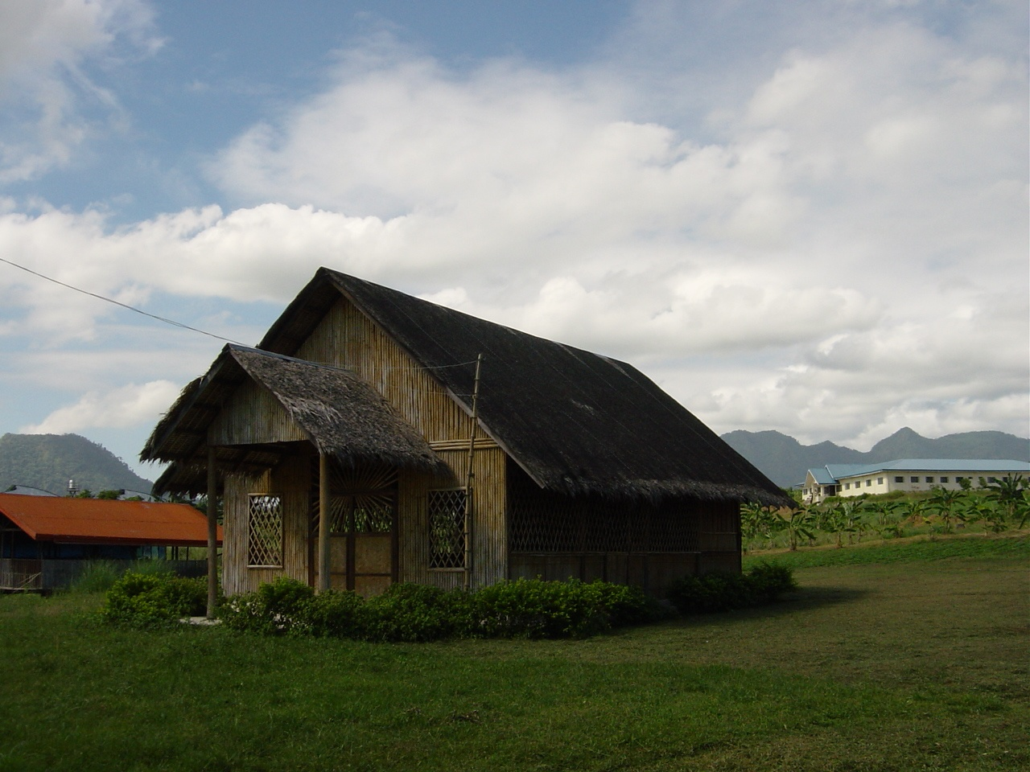
Thank You
World Canaan Movement
www.wcm.or.kr

