Slide 1

Pioneering History
(History of Korea’s Economic Development)
Canaan Farmers Training Center Medan, Indonesia

Slide 2
The model to develop both spiritual aspect and physical aspect - Korea
Korea was the poorest country in the world in 1953
Income per Capita
US$94 in 1961
After 60 years
335 times Increase
Income per Capita
US$31,489 in 2020
How this was possible?
Because
Transformation
This model can be applied to individual & community

Slide 3
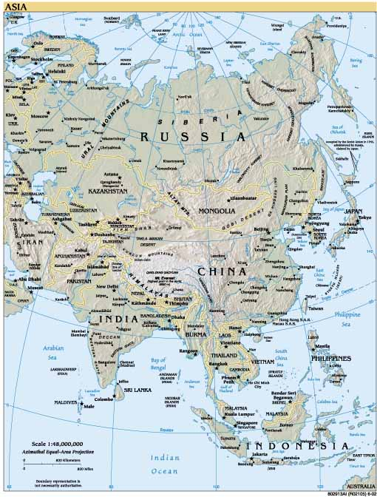
1. Overview
Geographical Importance of Korea
Russia
Korea
Center of China, Russia and Japan
China
Japan

Slide 4
Political and diplomatic influence on Korea from foreign country in 19th century
Joseon Dynasty
During the 19th century, Korea tried to control foreign influence by closing the borders to all nations except China.
China had an influence always in Joseon Dynasty
In 1871, US Korea Expedition
In 1866, French invasion
Korea
In 1897, Russia had an influence
In 1876, Japan forced to Korea open its ports
Korea became battlefield of foreign countries

Slide 5
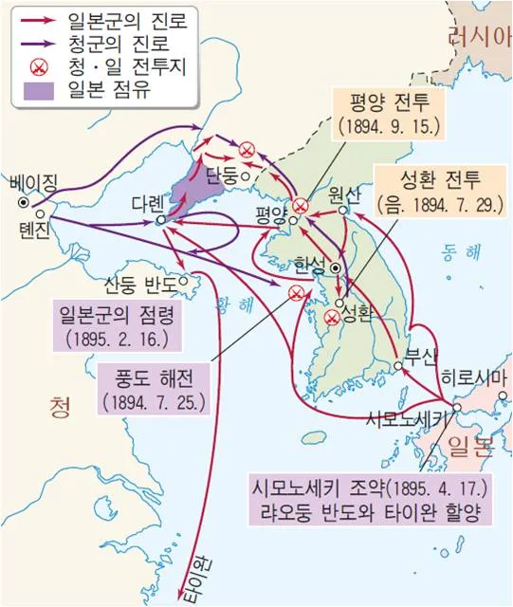
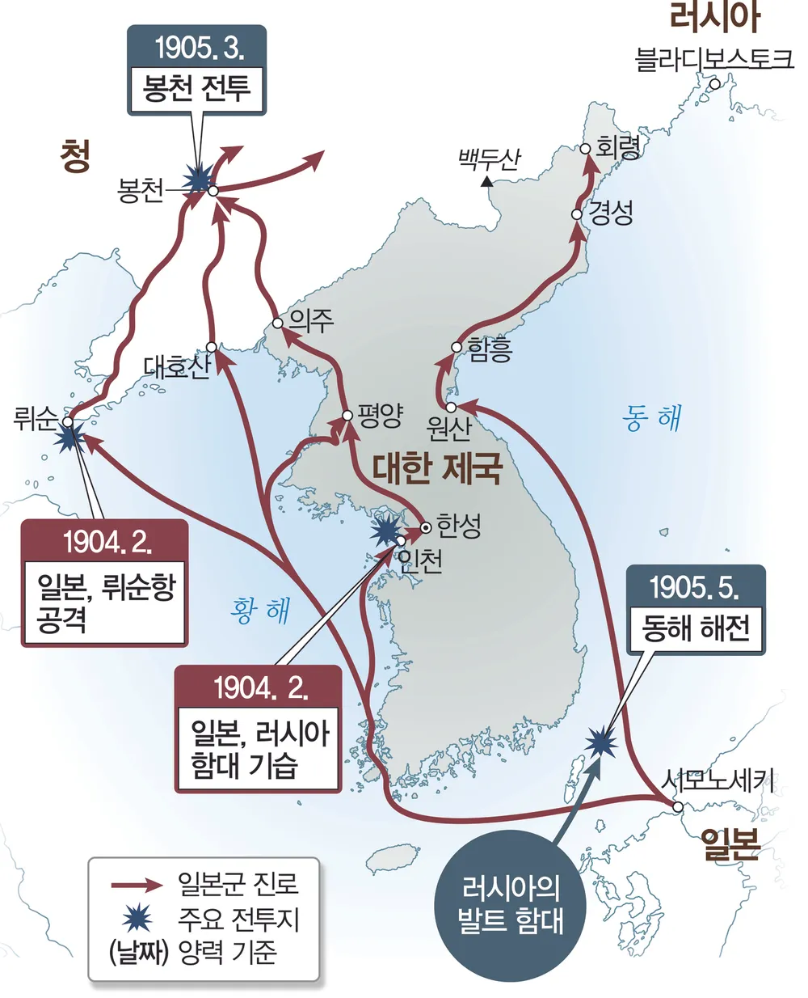
Japan created the war and tried to increase an influence on Korea
Sino-Japanese War 1894 - 1895
Victory of Japan
Russo-Japanese War 1904 - 1905
Victory of Japan
In 1910, Japan colonized Korea until 1945 for 36 years

Slide 6
Social and political background under Joseon Dynasty
Principles of Society,
Principles of ruling and administration
Confucianism
Four classes in the society
Yangban
(scholar-aristocrat)
Dominate government, the military, and society
Chung-in
(middle people)
Professionals such as government office or technical worker, doctors, and artists
Sangmin
(commoners)
Most of population like peasants, merchants, artisans
Cheonmin
(serfs, servants)
Low-born or outcasts

Slide 7
Contemporary History of Korea
Joseon Dynasty
Economic Exploitation (Land, Farm, Fishery, Industry)
Entire Land – Devastated
Japanese
Forced Occupied
Period
1910 - 1945
Banned to teach Korean language
Economy – Wrecked
Korean War
1950 - 1953
Japanese style education
Loss of Millions of People
Distortion of culture and history
POVERTY

Slide 8
Society of Korea in 1950s & Early 1960s
Legacy of Colony
(1910 – 1945)
Devastation from Korean War
(1950 – 1953)
Corruptive & Incompetent Governance
Economy trapped in a cycle of poverty and depend on Aid
Unstable society by ideological confrontation and disorder
Despair
Uncooperative
Loss of Hope

Slide 9
Economy in 1950s & Early 1960s
Economy trapped in a cycle of poverty
Low Production & Low productivity
Low Income
Low Savings
Low Investment
Rely on Foreign Aid
A leader and the people with a clear vision and strong will by transformation
Who can solve this problem?

Slide 10
Model of Development by Transformation – Korea
After 60 Years
Korea was the poorest country in the world in 1953
GDP per Capita
U$94/1961
Korea became developed Country
GDP per Capita US$31,489/2020
(335 times increase since 1961)
How ?
Transformation
Dream
Economic Development Plan
Saemaul Undong
New Village Movement
Foreign Capital Inflow
Industrialization
Export Promotion
Pioneering Spirit
Canaan Farmers School

Slide 11
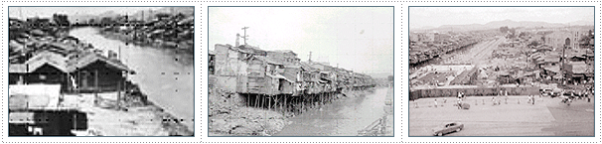
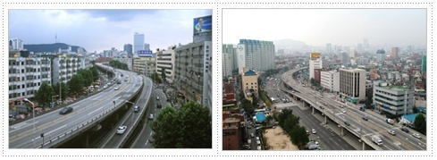
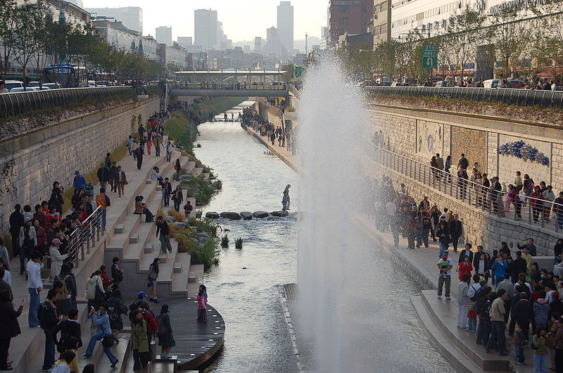
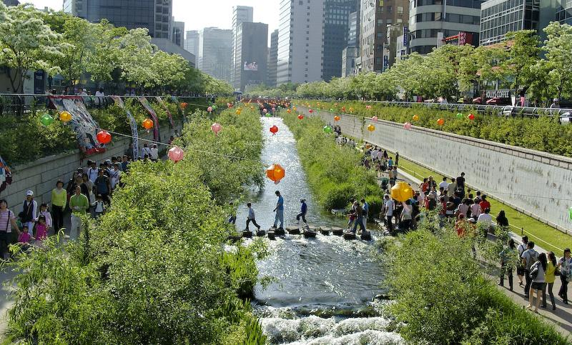
Chung Gae Stream
1953 – 1965, Life in Poverty
1975 – 2005, Industrialization
2005 – Present, Developed Country

Slide 12
Video: Korea Economic Development

Slide 13
Basic Foundation of Economic Growth (1948 – 1953)
Farmland Reform
Compulsory Education
1) Farmland Reform
Old Farmland System under Chosun Dynasty
Under the control of a centralized system of government.
Landlord
A small group consisting of royal family, the nobility, and bureaucrats in the center
Tenant Farmers
Most people were poor tenant farmers cultivating private or public land and paying tenant rental to the nobility or bureaucrats.

Slide 14
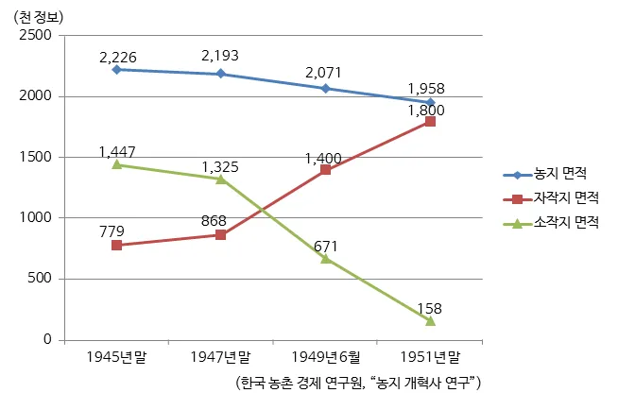
On August 15, 1945, 77% of population was engaged in agriculture
Status of tenant farmer & farmland size in August 1945
Tenant Farmer 86%
Tenant Farmland 65%
Farmland Reform Act on March 10, 1950.
Share of farmland before & after farmland reform
Approx. 1000 HA
Self-owned farmland 92%
Tenant farmland 8%
1945
1951

Slide 15
3) Compulsory Education System
6-year Compulsory Education Plan of Elementary School on June, 1950
The Education Act in 1949
The government increased the educational budget from 8.9% of the governmental budget in 1948 to 15.2% in 1960 in order to expand compulsory education and establish schools and classes.
As a result, the goal of the 6-year Compulsory Education Plan was achieved through reaching the rate of enrollment of 96% of all school-aged children by 1959

Slide 16
The Contribution of Farmland Reform and Education Act
6-years Compulsory Education Plan
Increasing elementary school students
Land Reform
Increasing high school and university students
Number of Students (1935 – 1963)
Unit: 1,000
 | 1935 | 1945 | 1952 | 1955 | 1960 | 1963
Elementary School | 717 | 1,366 (100%) | 2,369 | 2,877 (211%) | 3,621 | 4,422 (323%)
High School | 34 | 89 (100%) | 445 | 749 (842%) | 820 | 1,030 (1157%)
University | 3 | 8 (100%) | 33 | 79 (988%) | 98 | 127 (1587%)
Source: Ministry of Strategy and Finance

Slide 17
In Summary
After Establishment of Republic of Korea in 1948
Farmland Reform
New Education System
By President Syngman Rhee
Physical Capital
Human Capital
Economic Development Plan
Saemaul Undong
or
New Village Movement
By President Chung Hee Park

Slide 18
3. Economic Development Plan (1962 – 1971)
1) Economic environment of the early 1960s
Basically, Korea lacks resources.
Major Problems
Shortage and No Resources of Capital
Technical Weakness
Undeveloped Business and Industry
Solution?
What we have?
Strong economical and political will
Outward- oriented development
Abundant manpower with good education

Slide 19
2) Mechanism of outward-oriented economic development strategies
Foreign Capital Inflow (Foreign Investment, Loan, Aid)
Import of Capital Goods
Government Support
Import of Raw Material
Import of Technology
Technical Development,
Educated Manpower’
Tax Incentive,
Export Loan
Private Enterprise
Reproduction
Export
Economic Growth

Slide 20
Summary of Economic Development Plan (1962 – 1971)
Foreign Capital Inflow
Industrialization
Export Promotion
Well Educated Manpower
Strong Entrepreneurship & Government Support
Problem
Higher Economic Growth
Imbalance in distribution of income between urban labor and rural farmers
Saemaul Undong or New Village Movement

Slide 21
Model of Development by Transformation – Korea
After 60 Years
Korea was the poorest country in the world in 1953
GDP per Capita
U$94/1961
Korea became developed Country
GDP per Capita US$31,489/2020
(335 times increase since 1961)
How ?
Transformation
Dream
Economic Development Plan
Saemaul Undong
New Village Movement
Foreign Capital Inflow
Industrialization
Export Promotion
Pioneering Spirit
Canaan Farmers School

Slide 22
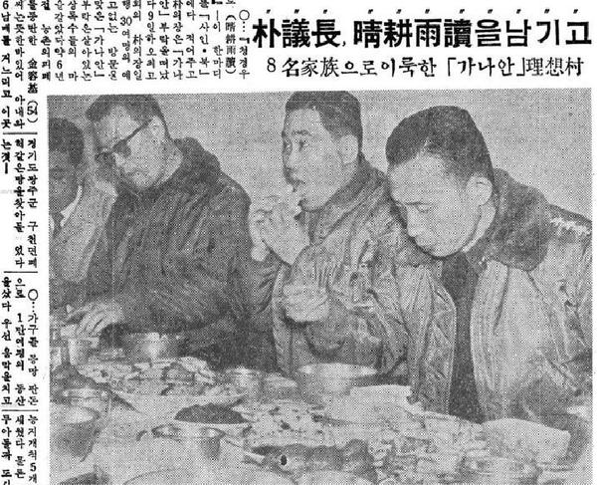
Canaan Farmers School was founded by Elder Yong Ki Kim in 1962
Former President Park Chung-hee visited Canaan on February 9, 1962.
Birth of Saemaul Undng or New Village Movement in 1970
Kyunhyang Newspaper February 1962

Slide 23
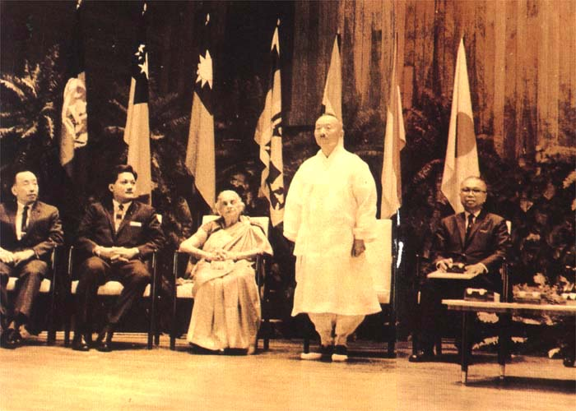
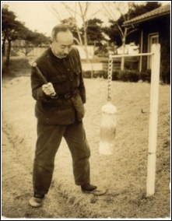
Dr. Yong Ki Kim was a Magsaysay Awardee for Social Service in1966
1966년 막사이사이상 수상(고무신과 두루마리를 입음)
Oh my country, take courage
He loved his country and people
If you don’t like to work, do not eat
He emphasized hard work and diligence
With the Bible in one hand and a hoe in the other
He practiced the Word of God in his life
Pioneering Spirit
Contribution of Economic Growth in Korea

Slide 24
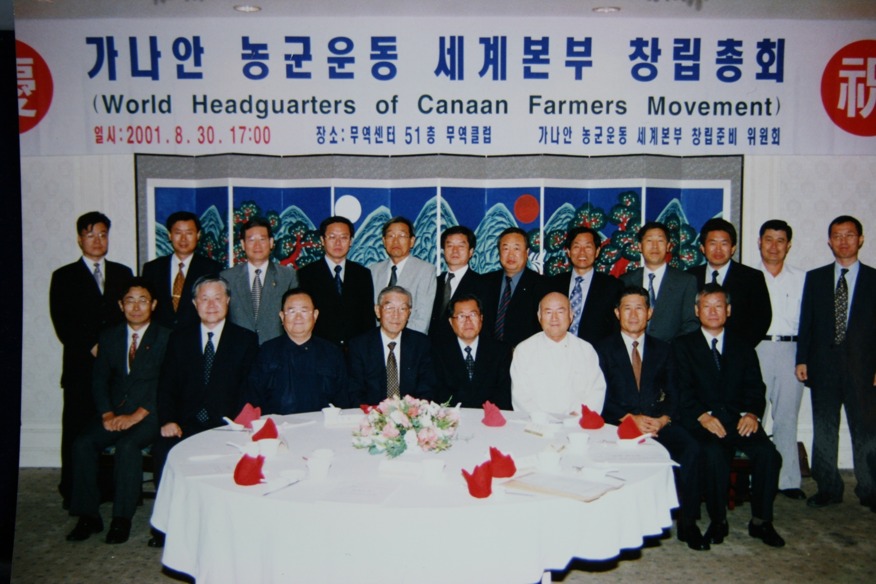
To the world – Established World Canaan Movement in 2001

