Slide 1
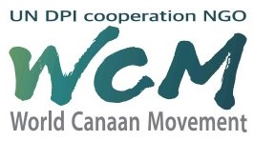
Why Do We Need World Canaan Movement?
Canaan Farmers Training Center Medan, Indonesia

Slide 2
Vison of World Canaan Movement
To eradicate spiritual and material poverty worldwide and build a sustainable society through spiritual transformation and a revolution in living attitude based on the Pioneering Spirit
Eradication of spiritual and material poverty
Spiritual Independence
&
Economical Self-Reliance
Build a sustainable society

Slide 3
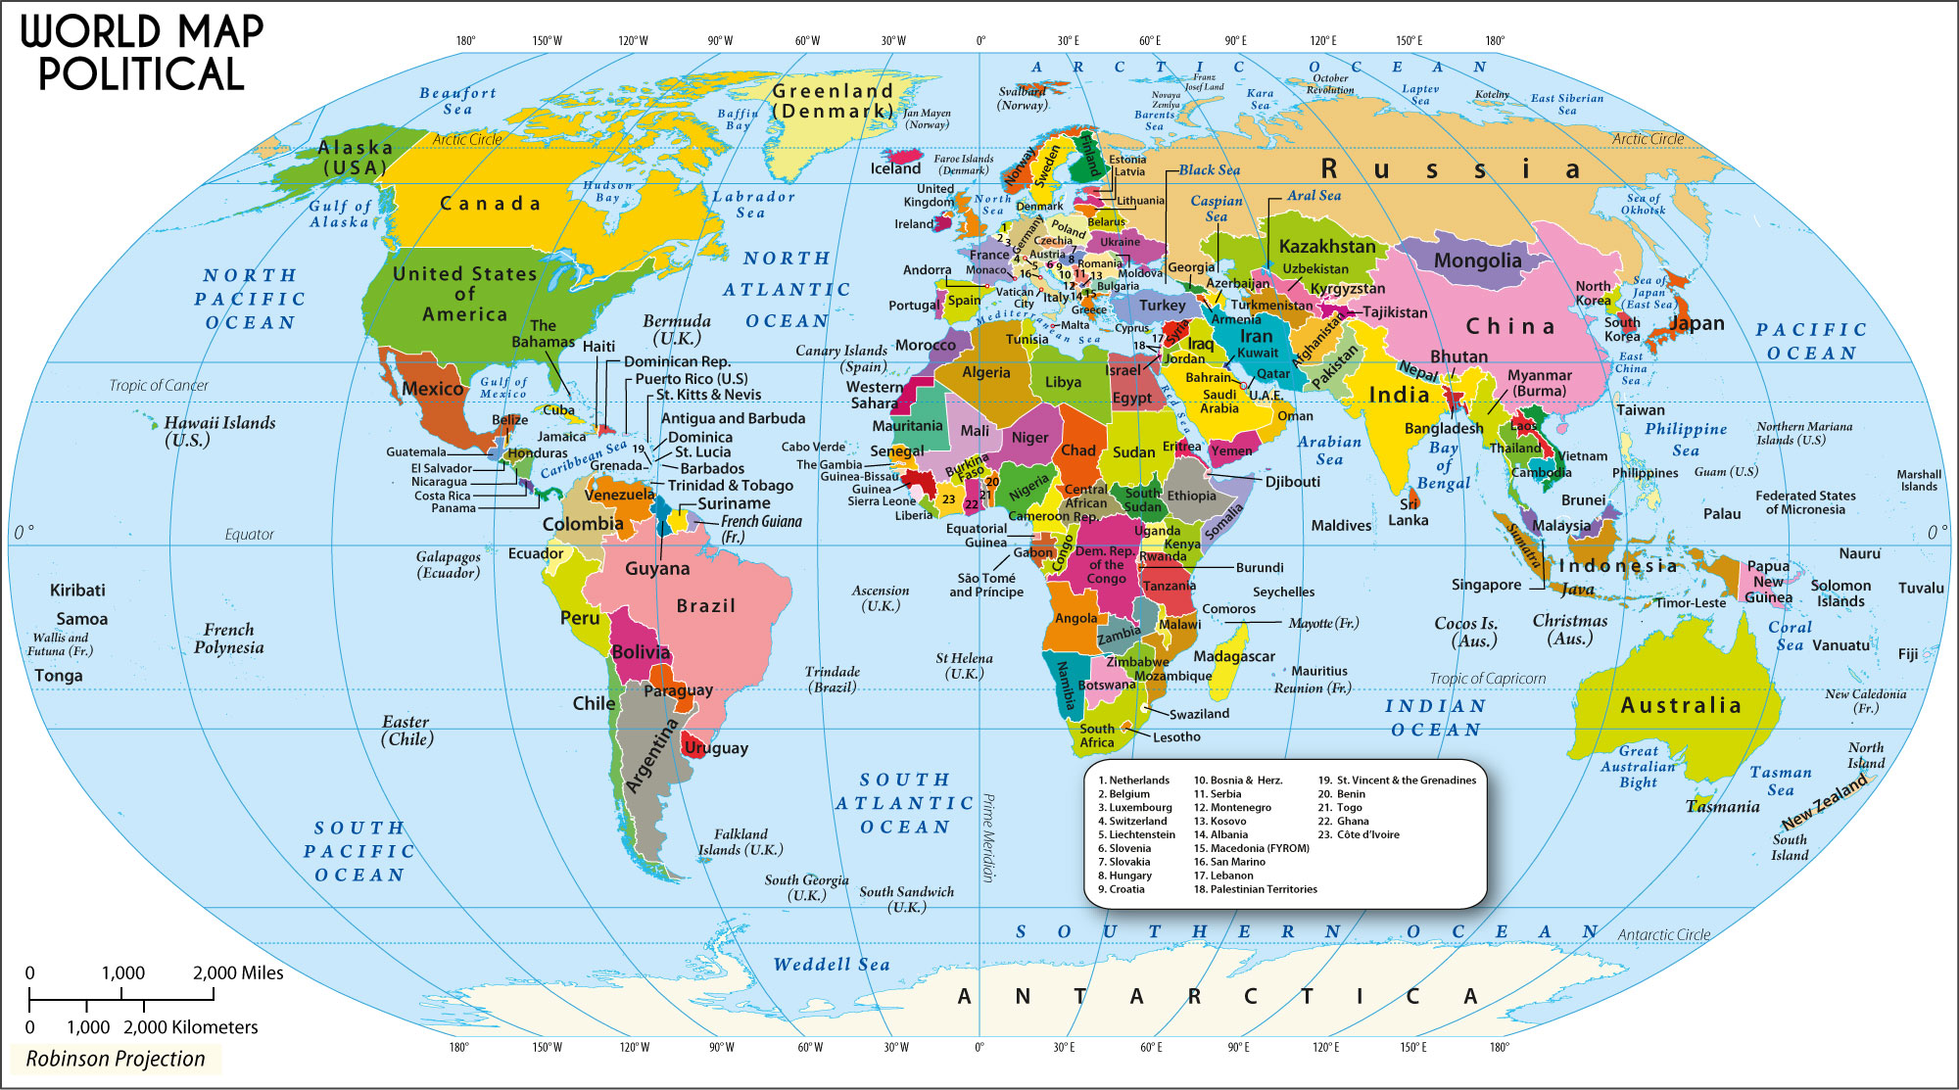
What is major problems in this world ?
- Spiritual and Physical Poverty
Are we living in chaos?
- Broken Family
- Selfishness
- Violence
Yes or No
- Regional Conflict & War
We need to challenge to overcome the difficulties we are encountering
- Climate Change
- Financial Crisis
- Pandemic
Improving the quality of life

Slide 4
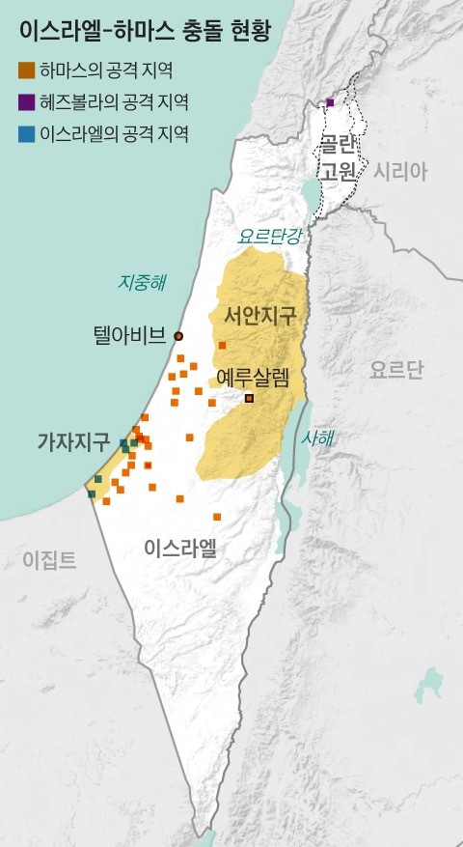
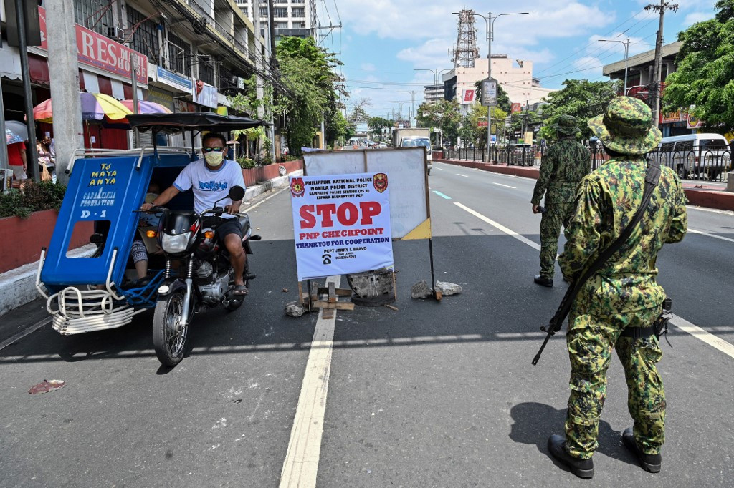
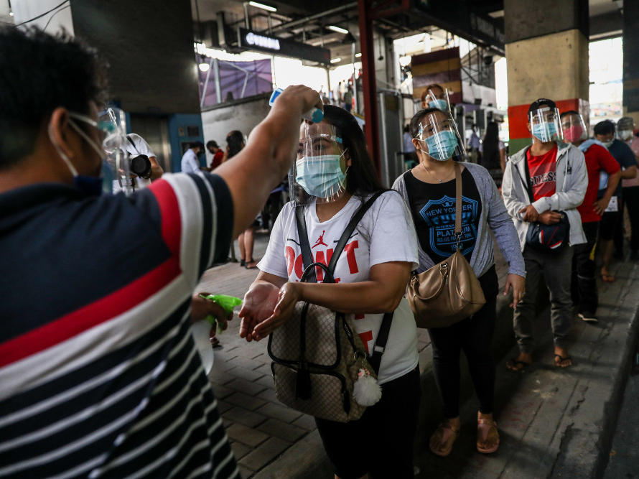
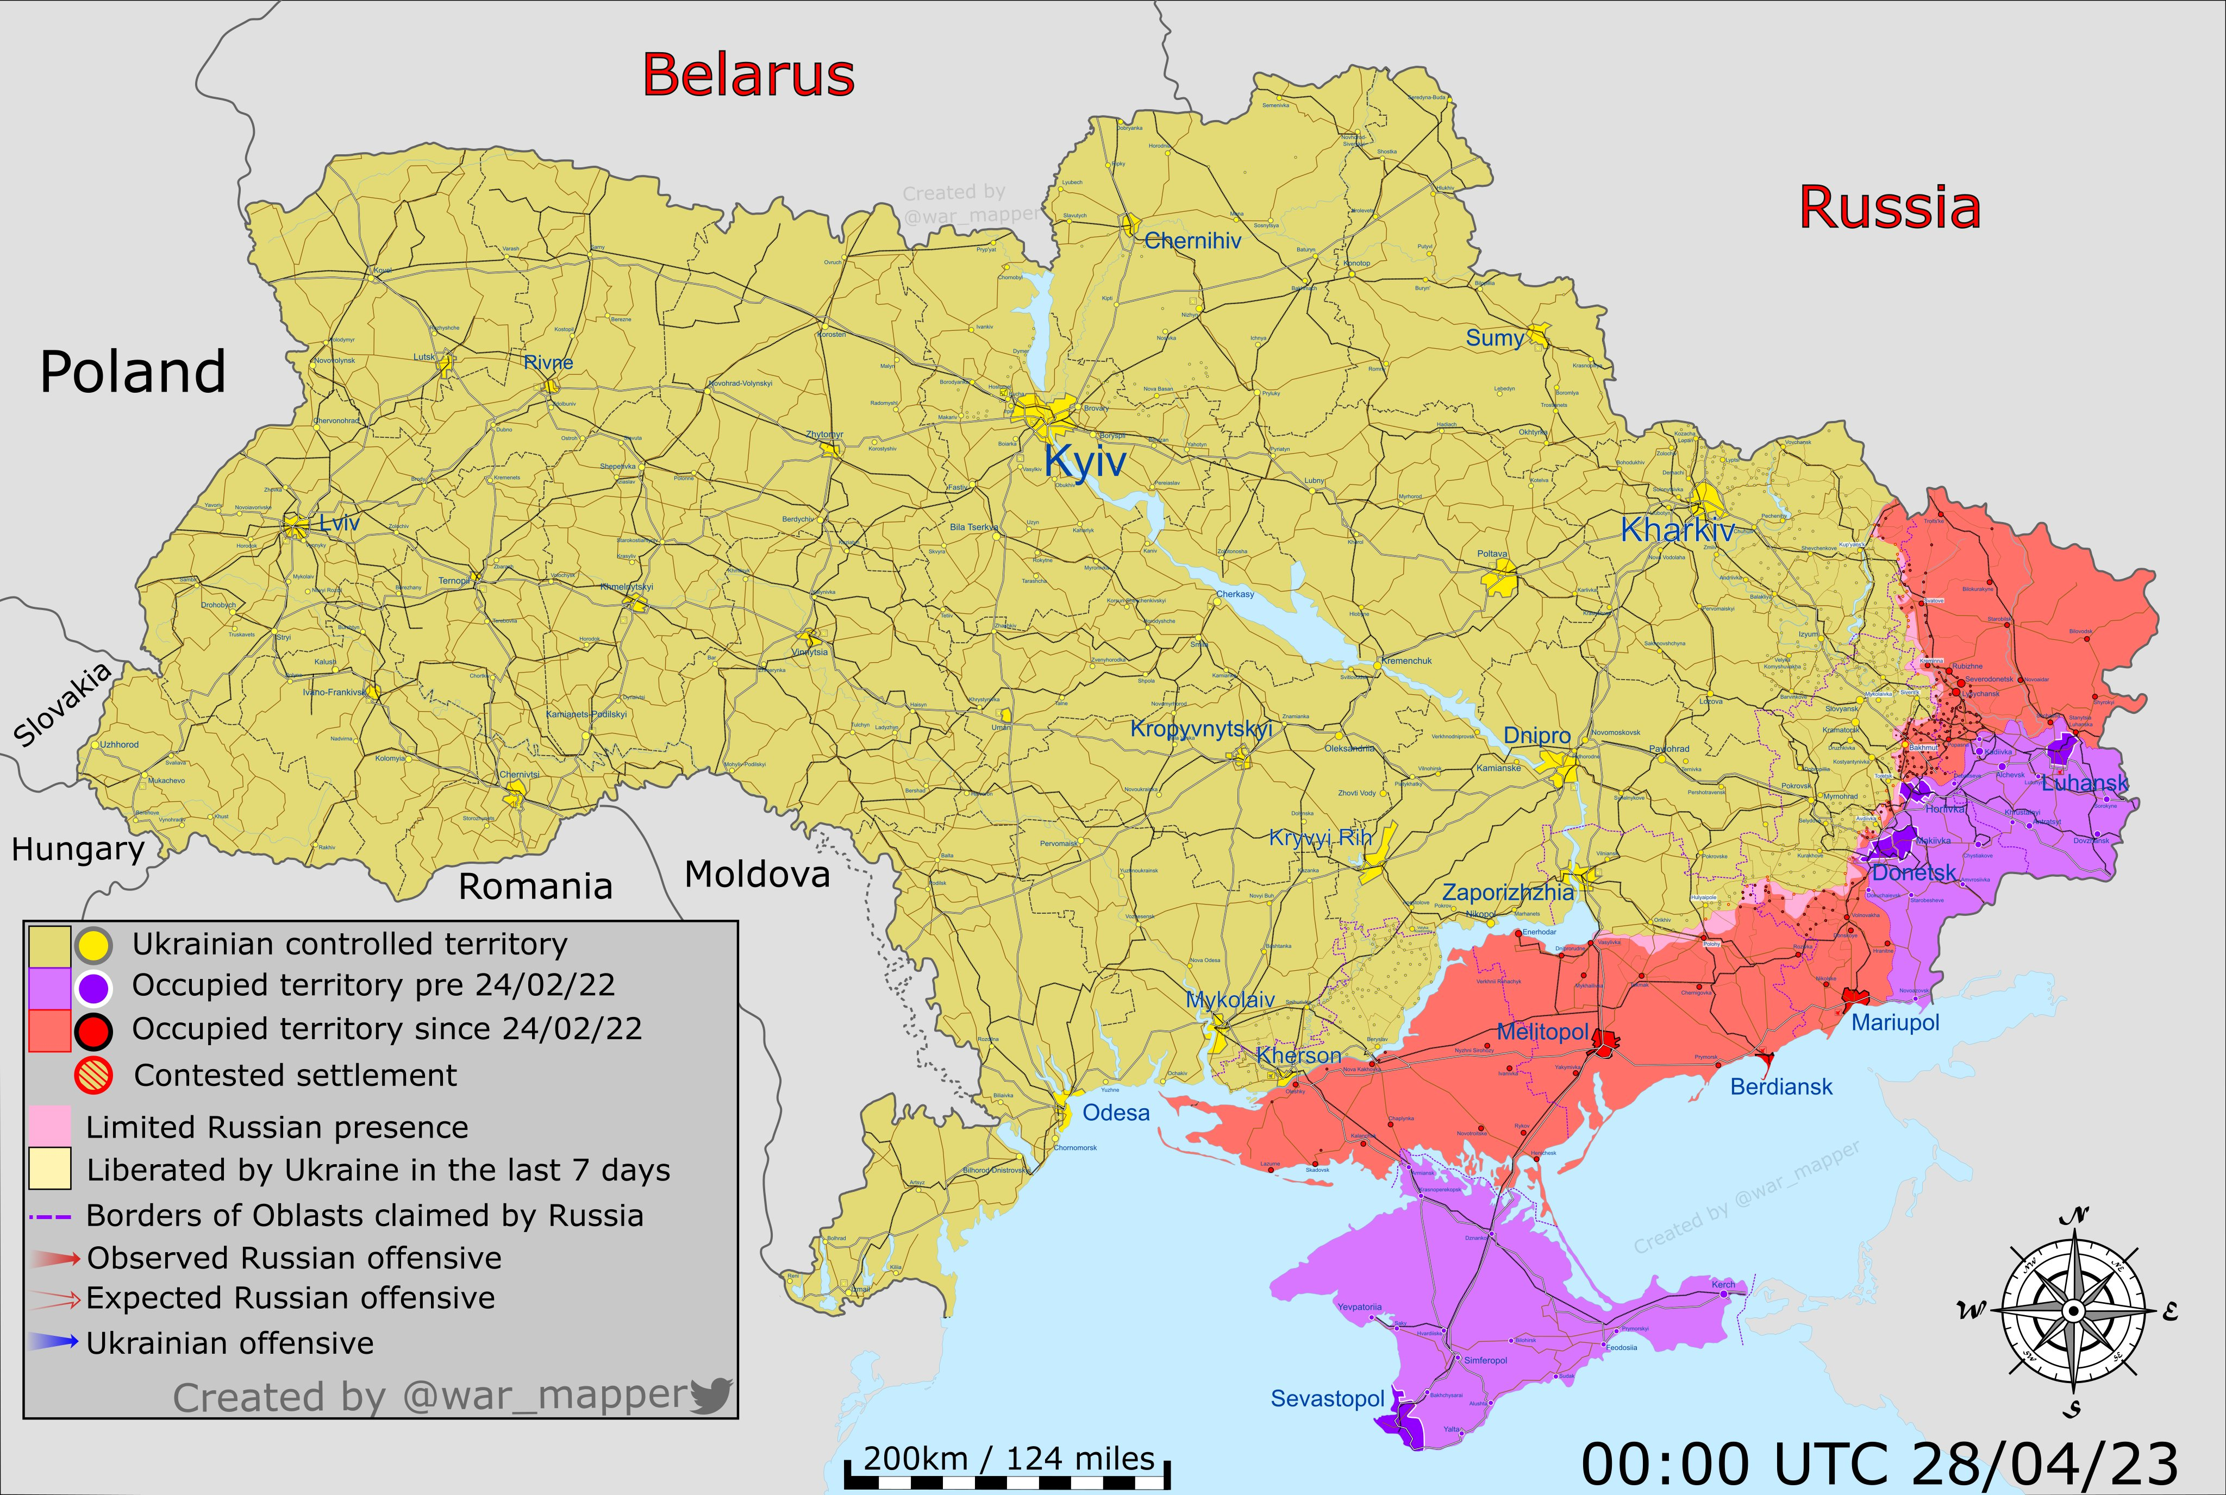
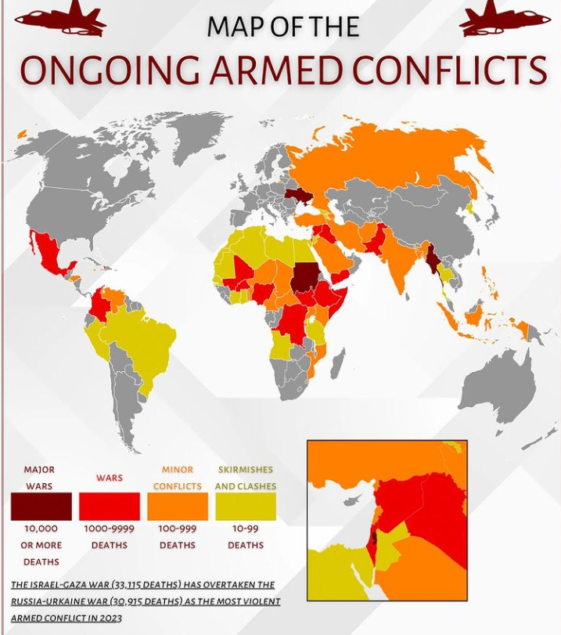
We were experienced and are now experiencing in the world
Pandemic – Covid 19 Experience
Middle East Crisis
War Between Ukraine and Russia
Lockdown & Check Point
Face Mask
Conflict in the World
Tariff War
Ideological and Religious Confrontation

Slide 5
What was changed and what will be changed in the future
From Globalization
to Deglobalization
Most Serious Problem
Spiriual and Physical Poverty
Statism,
Restructuring International Order, International Conflict,
Maximizing National Interest
Politics
Global Supply Chain Restructuring,
Global Economy Slowdown,
Rising Food Insecurity, Increasing Poverty, Increasing Industry 4.0
Economy
Social Chaos Due To Economic Inequality,
Digital Platform,
International Development and Reconstruction, Change of Lifestyle
Society

Slide 6
Our life in this earth is limited
How can we make a better and fruitful life in this earth
Human Being (Life) = Spirit + Body (Flesh)
Human Being
Spirit (Mindset)
Body (Flesh)
Control
Good Determination
Good Action & Good Result
Transformation of Mindset
Good Economical Foundation
We need to cultivate our life by transformation of mindset
and economical foundation

Slide 7
Elements needed to improve quality of life
Spiritual Aspect
Physical Aspect (Economy)
Should work in combination
No matter how much resources and capital they have, if the spirit of the person using those resources and capital is not right, those resources and capital will not be used well and will be wasted, ultimately lowering the quality of life.
Even if the resources and capital are small, if the spirit of the person using the resources and capital is right and enterprising, the quality of life will improve and influence those around them.
Korea is a model that has achieved economic development through the combined effects of spiritual and physical aspects, that is, economic aspects.

Slide 8
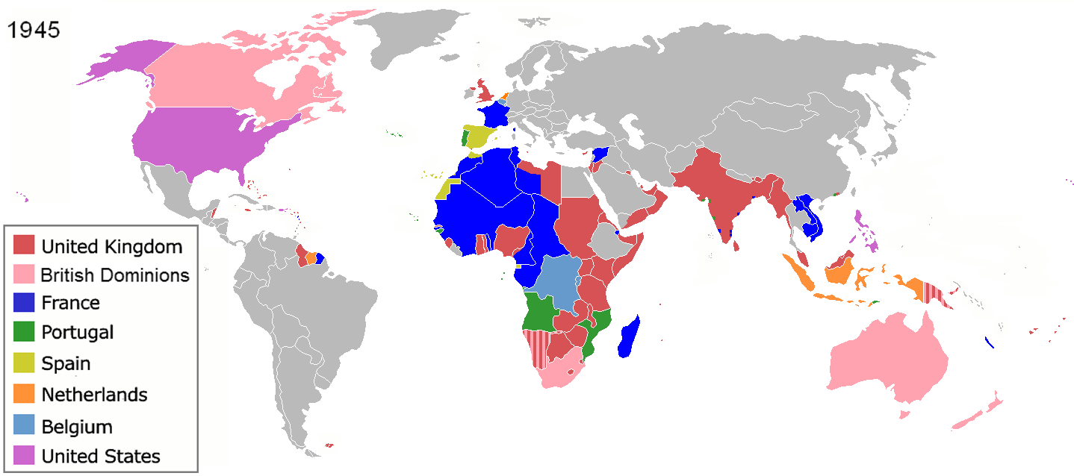
1. Poverty History
The World War II was the turning point of the world history
Beginning in 1945, Asian and African countries that had been colonized by the West began to gain independence
Poor Countries

Slide 9
World Poverty by Income
Year 2025
International poverty line by the World Bank
World Population in 2025: 8,200 Million
Poverty Line base on 2021 PPP(Purchasing Power Parity) Income
9.9%
812 Million
Low-Income Countries
U$3/ Day
18.1%
1,484 Million
Lower-Middle Income Countries
U$4.2/ Day
45.5%
3,731Million
Upper-Middle Income Countries
U$8.3/ Day

Slide 10
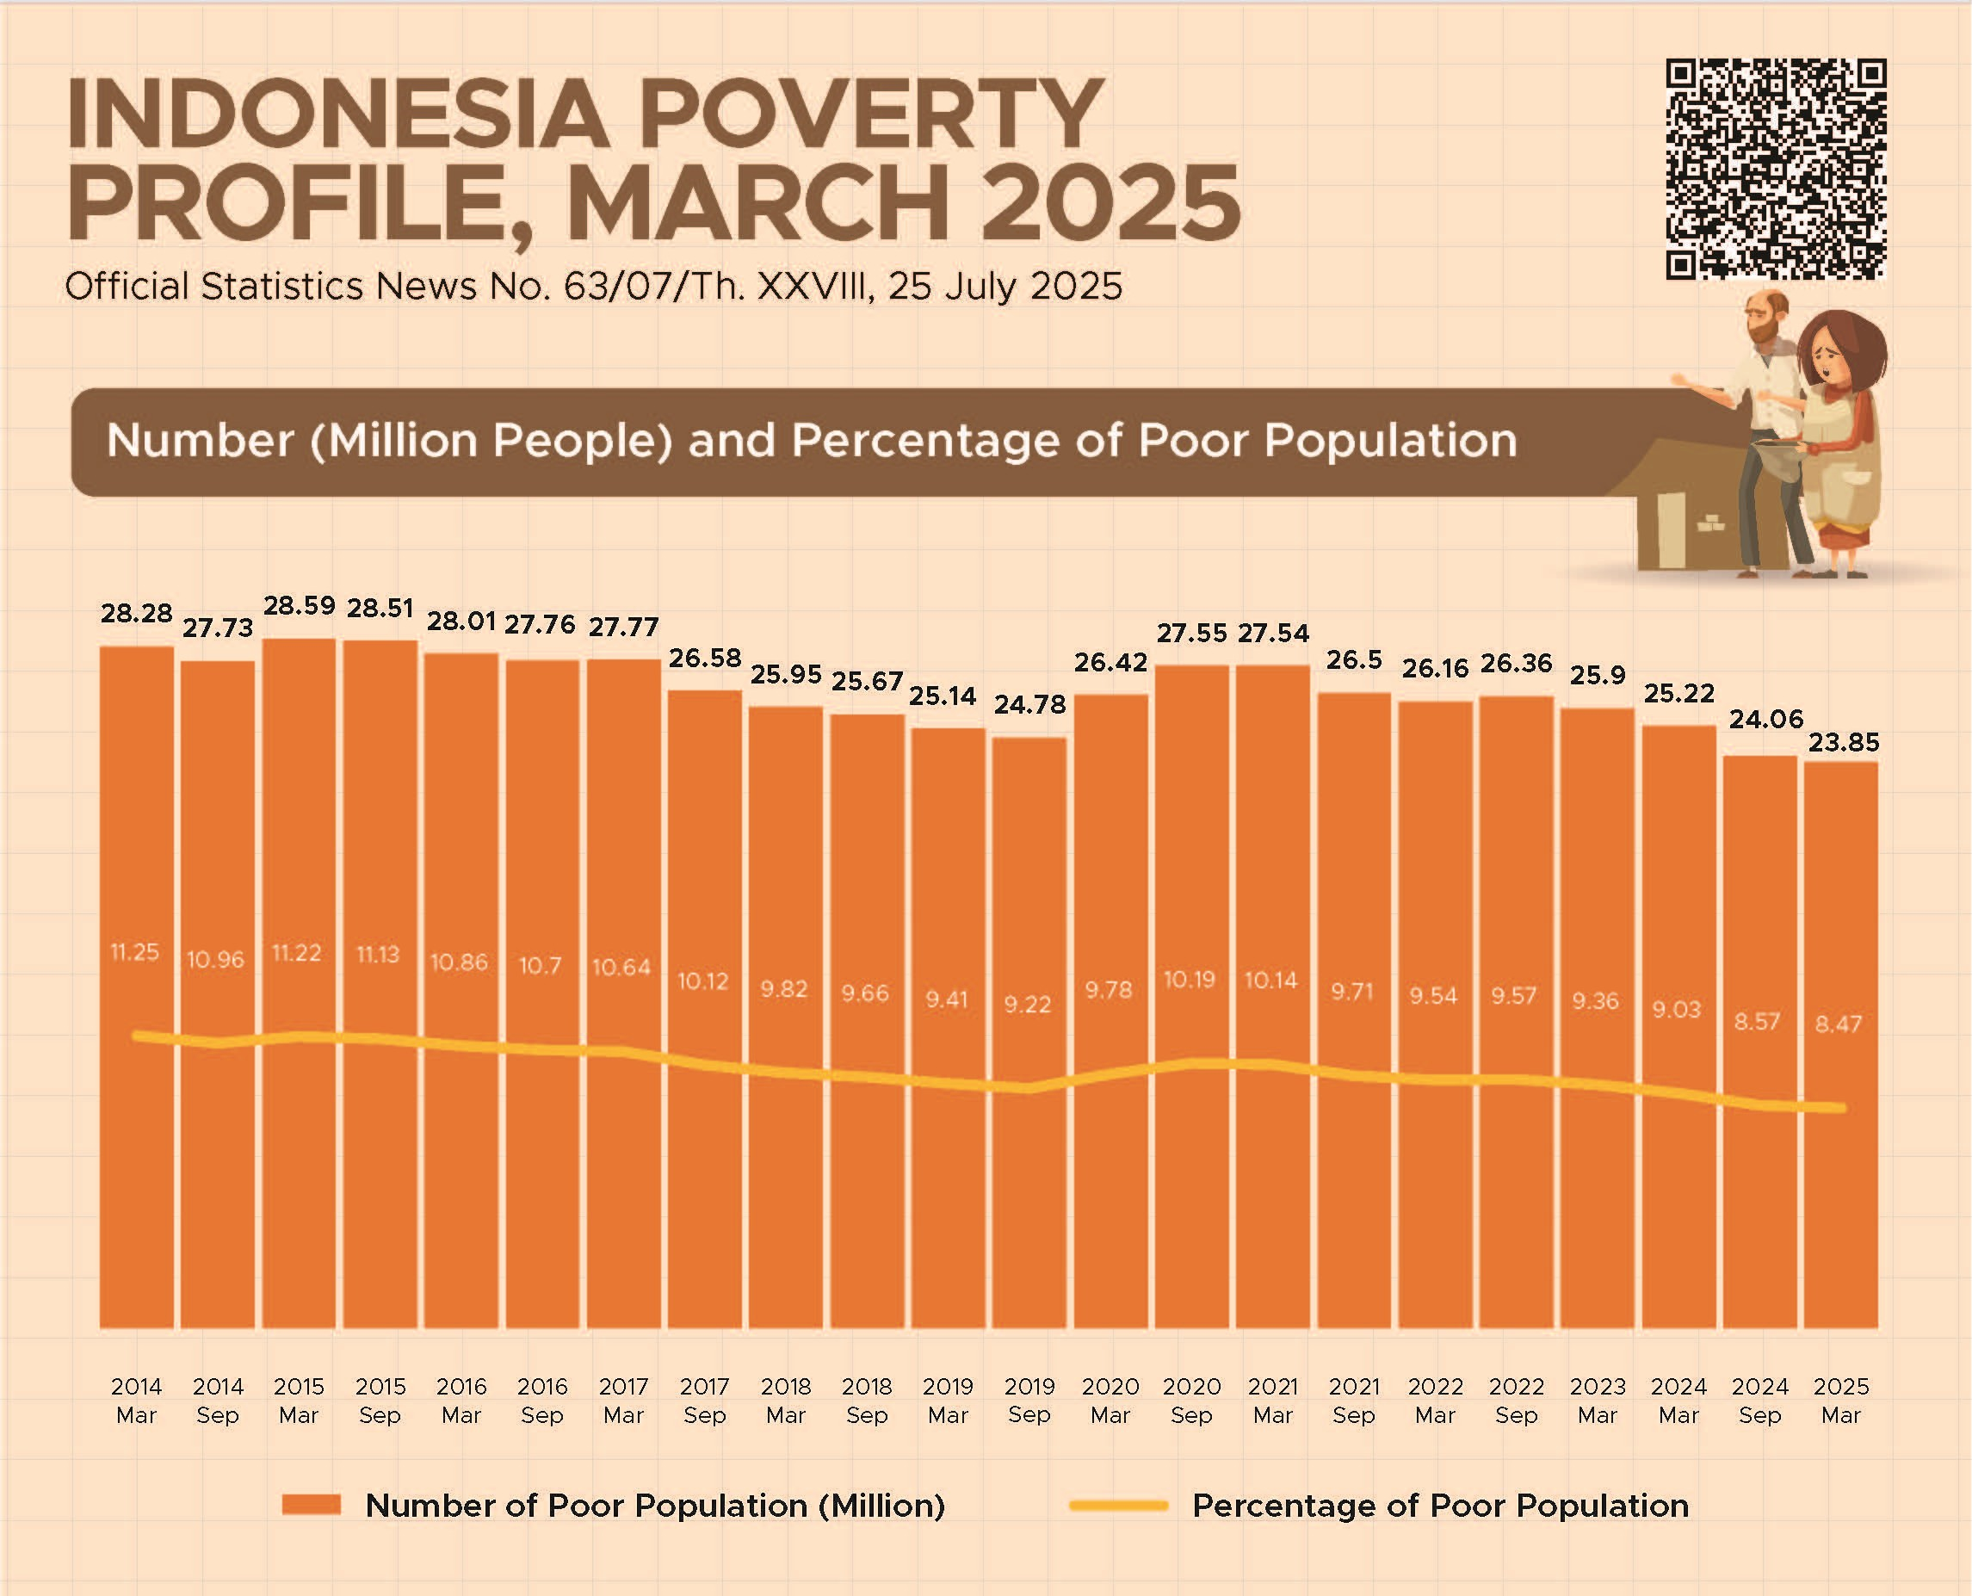
Number
23.85 Million
8.47 %
Poverty Line: IDR 609,160 / Month

Slide 11
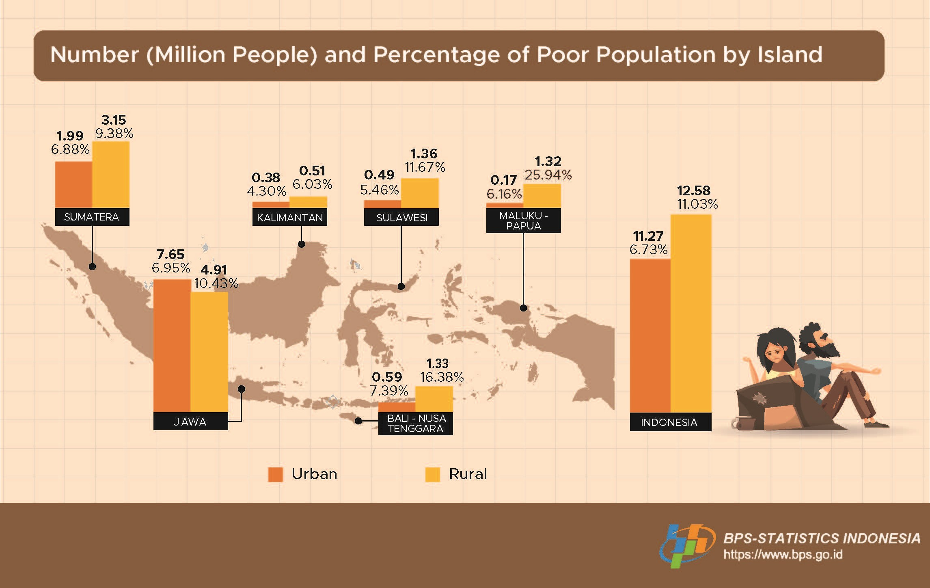

Slide 12
2. Reasons of Poverty
Why haven't the new countries been able to get out of poverty
after World War II?
$
Huge Amount of Aid
Developed Countries
Developing Countries
Losing of sustainable growth
Colony in Economy
Still Poor
Corruption
Laziness
Dependence
Why New Countries Are Poor?
Aid recipient countries become accustomed to receiving
Developed the mindset of dependency.
Merely relying on aid from foreign countries or other people
To achieve sustainable development and growth in order to eradicate poverty, they need to learn how to cultivate their life

Slide 13
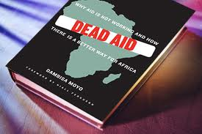
Dr. Dambisa Moyo
Author,
Zambian- born Economist
In the past fifty years, more than $1 trillion in development related aid has been transferred from rich countries to Africa. Has this assistance improved the lives of Africans? No. In fact, across the continent, the recipients of this aid are not better off as a result of it, but worse—much worse.
How can we eradicate poverty and improve the quality of life ?
Learn from Korean model of development

Slide 14
The model to develop both spiritual aspect and physical aspect - Korea
Korea was the poorest country in the world in 1953
Income per Capita
US$94 in 1961
After 60 years
335 times Increase
Income per Capita
US$31,489 in 2020
How this was possible?
Because
Transformation
This model can be applied to individual

Slide 15
Korean Model of Development
After 60 Years
Korea was the poorest country in the world in 1953
GDP per Capita
U$94/1961
Korea became developed Country
GDP per Capita US$31,489/2020
(335 times increase since 1961)
How ?
Transformation
Dream
Economic Development Plan
Saemaul Undong
New Village Movement
Foreign Capital Inflow
Industrialization
Export Promotion
Pioneering Spirit
Canaan Farmers School

Slide 16
To eradicate poverty and improve the quality of life, World Canaan Movement introduce how people can cultivate their life by Transformation and Pioneering Spirit
Cultivation of Life
Canaan Movement
Training
Education
Transformation
Pioneering Spirit

