Slide 1

Why Do We Need World Canaan Movement?
Canaan Farmers Training Center Medan, Indonesia

Slide 2
Vison of World Canaan Movement
To eradicate spiritual and material poverty worldwide and build a sustainable society through spiritual transformation and a revolution in living attitude based on the Pioneering Spirit
Eradication of spiritual and material poverty
Spiritual Independence
&
Economical Self-Reliance
Build a sustainable society

Slide 3
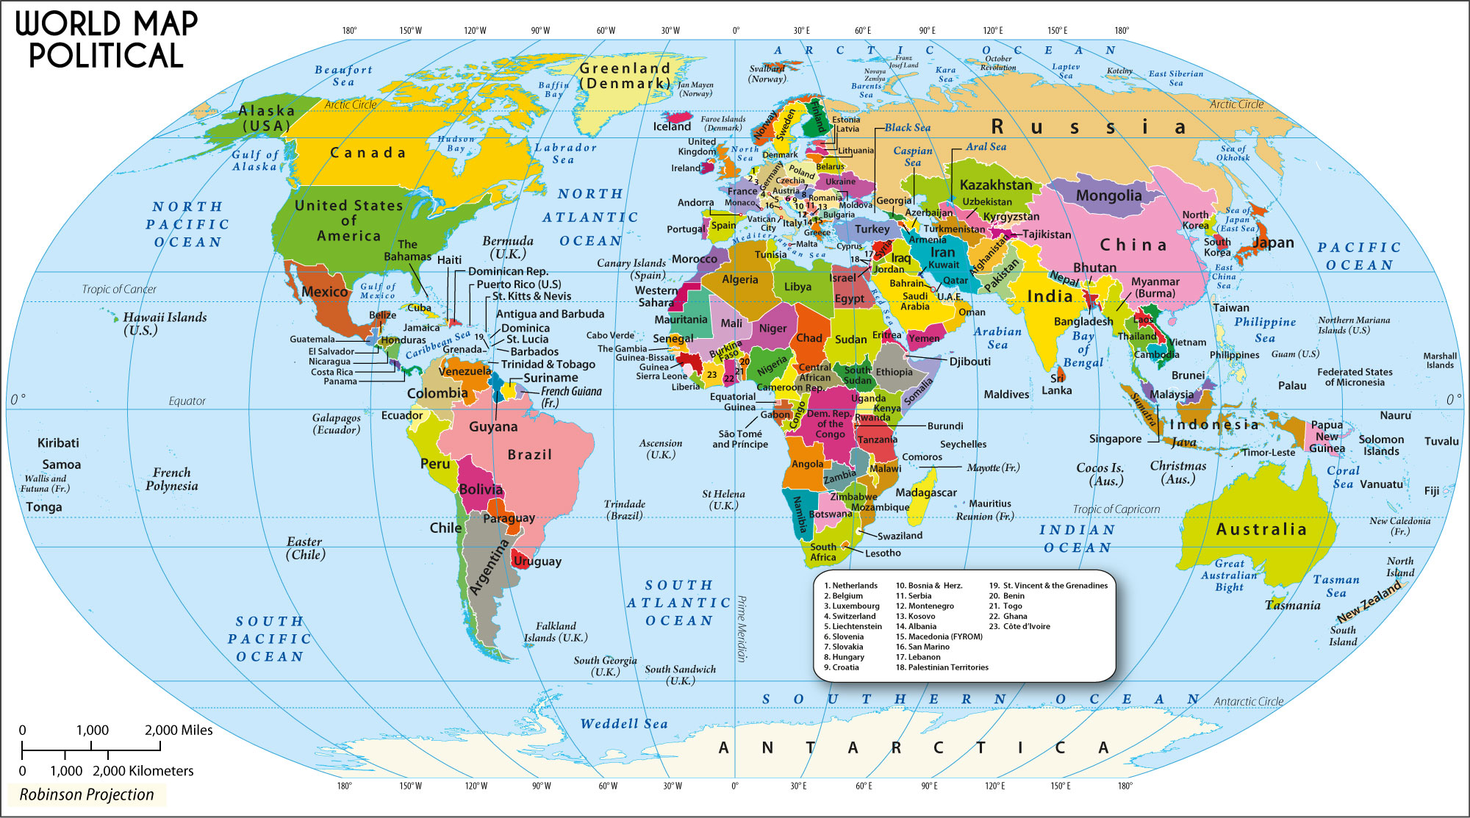
1. What is major problems in this world ?
- Spiritual and Physical Poverty
- Broken Family
Are we living in chaos?
- Selfishness
- Violence
- Regional Conflict & War
Yes or No
- Climate Change
We need to challenge to overcome the difficulties we are encountering
- Financial Crisis
- Pandemic
Serious problem is Spiritual & Physical Poverty

Slide 4
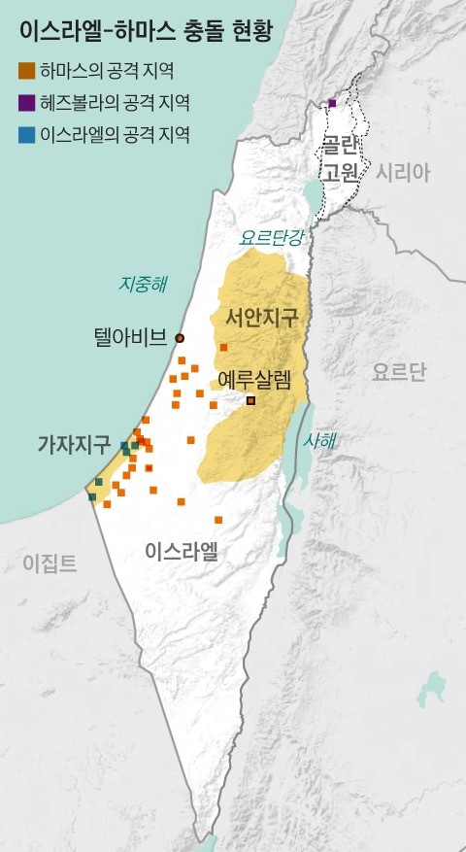
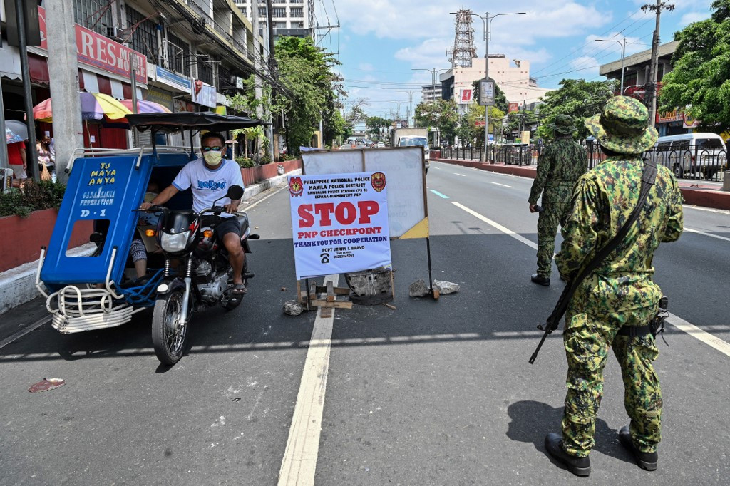
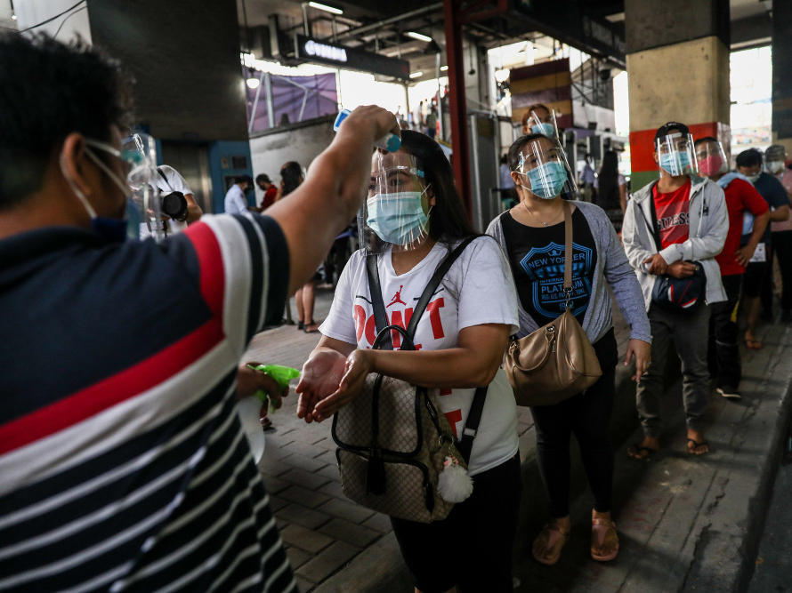
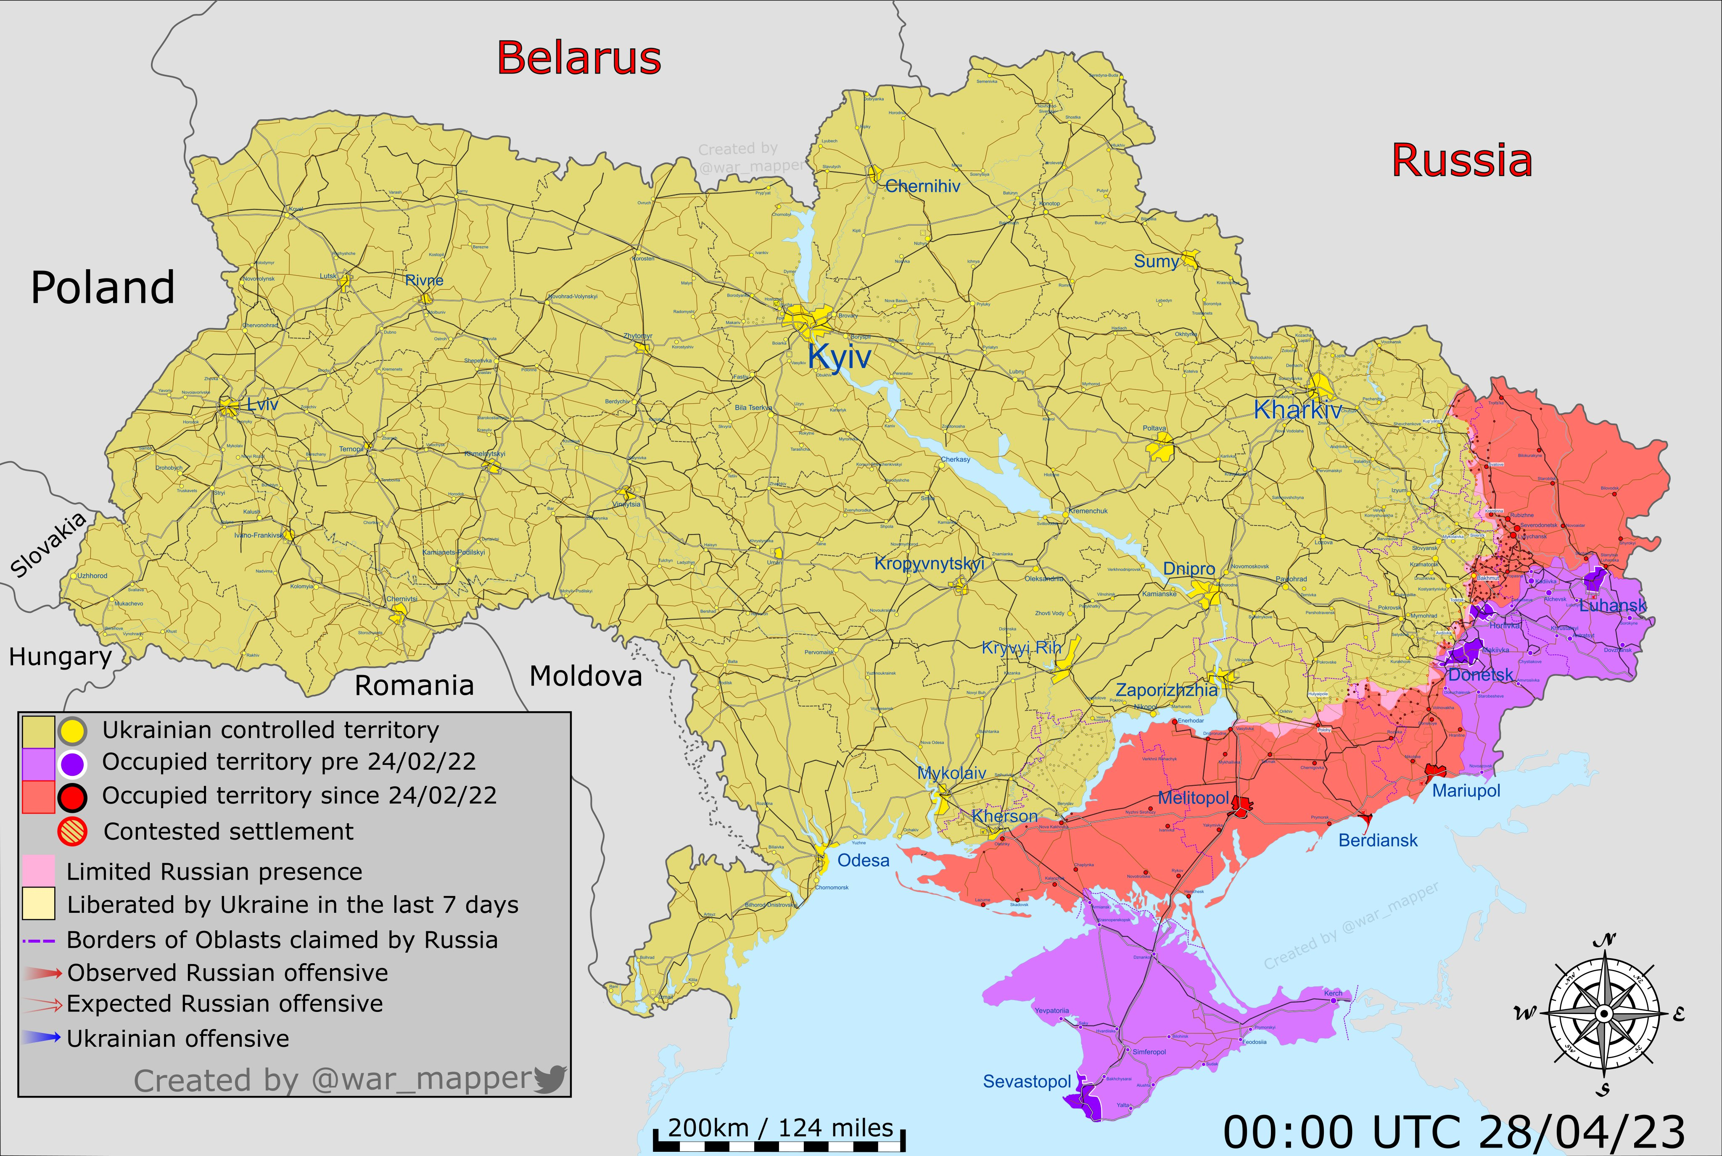
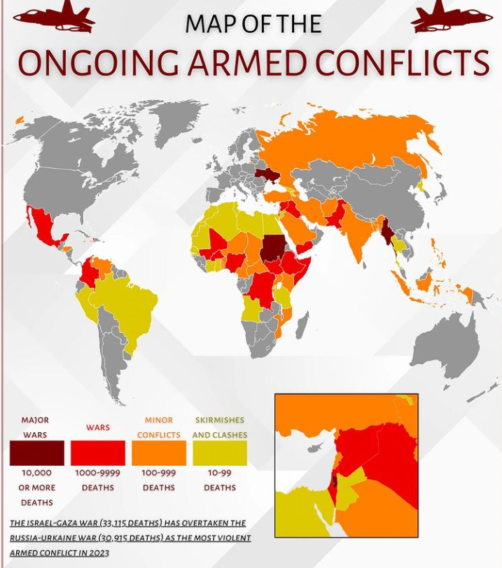
We were experienced and are now experiencing in the world
Pandemic – Covid 19 Experience
Middle East Crisis
War Between Ukraine and Russia
Lockdown & Check Point
Face Mask
Conflict in the World
Tariff War
Ideological and Religious Confrontation

Slide 5
What was changed and what will be changed after pandemic and war?
From Globalization to Deglobalization
Statism, Change of Politics, Regional Alliance, Restructuring International Order, International Conflict, Maximizing National Interest
Politics
Global Supply Chain Restructuring, Global Economy Slowdown, Inflation, Rising Food Insecurity, Increasing Poverty, Increasing Industry 4.0
Economy
Social Chaos Due To Economic Inequality, Digital Platform, Expansion of Online, Social Isolation, Humanitarian Project, International Development and Reconstruction, Change of Lifestyle
Society
The most serious problem is increasing of spiritual and physical poverty

Slide 6
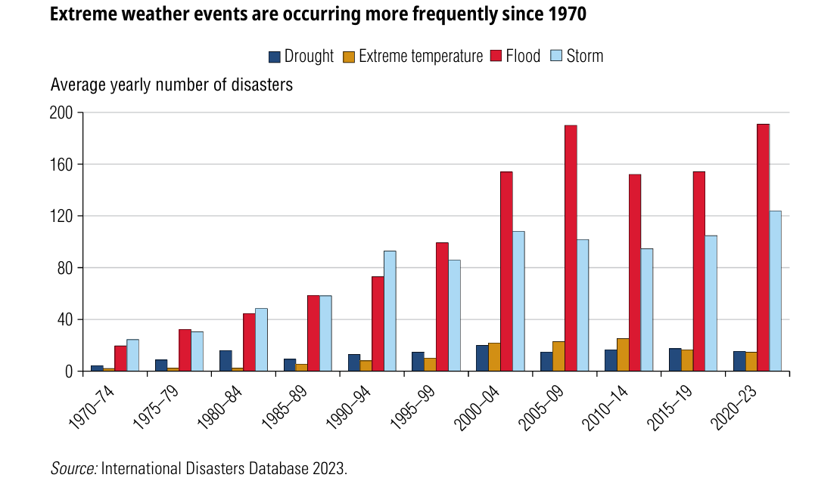
Extreme Weather Change
By World Bank

Slide 7
What lessons can we learn from this realty?
What causes viruses in animals to spread to humans?
Why is there a constant war going on in this world?
Why are natural disasters occurring due to rapid climate change?
It is the fault or mismanagement of human
Genesis 1: 26, 28 <Then God said, "Let us make man in our image, in our likeness, and let them rule over the fish of the sea and the birds of the air, over the livestock, over all the earth, and over all the creatures that move along the ground.“
God blessed them and said to them, "Be fruitful and increase in number; fill the earth and subdue it. Rule over the fish of the sea and the birds of the air and over every living creature that moves on the ground.“>
God’s Command
Subdue the earth
Rule over all creatures
It includes that human shall protect all creatures created by God

Slide 8
Subdue the earth
To develop the land properly suitable for the purpose of God
Rule over all creatures
To control or overlook all creatures properly in the eyes of God
Man did not obey God’s command
Focused on human eyes, not on God's eyes
Humans have destroyed nature and severed their relationship with God
What was the result ?

Slide 9
2. Preparation of New Era
Romans 8: 19-22 <The creation waits in eager expectation for the sons of God to be revealed.
For the creation was subjected to frustration, not by its own choice, but by the will of the one who subjected it, in hope
That the creation itself will be liberated from its bondage to decay and brought into the glorious freedom of the children of God.
We know that the whole creation has been groaning as in the pains of childbirth right up to the present time.>
God gave humans authority and responsibility to rule the world.
However, humans did not fulfill their responsibility to God and made all creation groan.
Could it be that the groaning creature is challenging man?
How can we solve this?

Slide 10
How can we solve these serious problems?
We, who are experiencing a war and pandemic, must prepare for the future
New Normal or New Era ?
Need to change our concept about the future
New Era
Will we be able to return to the free life we ​​once enjoyed in the future?
Or will we face a new era that is not a new normal that we have not predicted
Need to prepare a new era

Slide 11
Preparation of New Era
Need for Transformation of Human
The problem is not in the environment, but in people
Romans 12:2 <Do not conform any longer to the pattern of this world, but be transformed by the renewing of your mind. Then you will be able to test and approve what God's will is--his good, pleasing and perfect will.>
To transform people
Transformation of Mindset
Spiritual Independence & Economical Self-Reliance
Canaan Movement is to change or transform the people by transforming their mindset.

Slide 12
3. Poverty
What is the meaning of poverty ?
- Hunger
- Lack of shelter
- Being sick and not being able to see doctor
- Not being able to go to school and not knowing how to read
- Not having a job and fear for the future, living one day at a time
- Losing a child to illness brought by unclean water
- Powerless, lack of representation and freedom

Slide 13
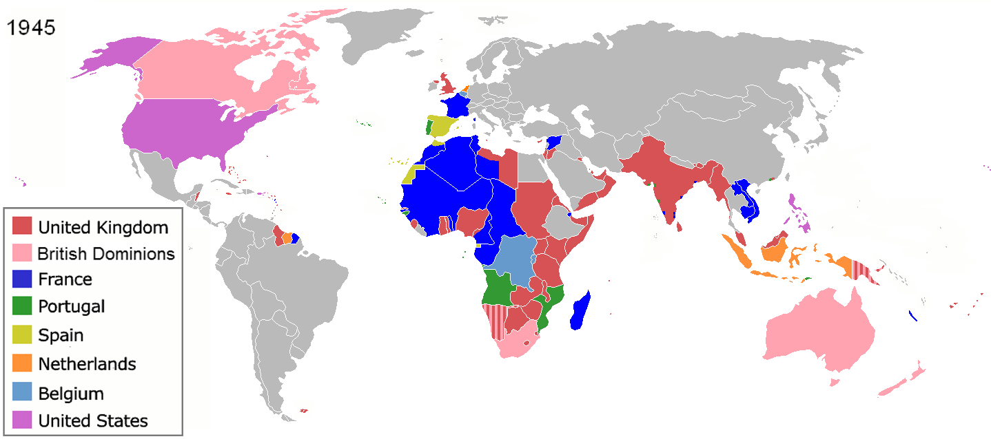
3. Poverty
1) Poverty History
The World War II was the turning point of the world history
Beginning in 1945, Asian and African countries that had been colonized by the West began to gain independence
Poor Countries

Slide 14
World Poverty by Income
Year 2025
International poverty line by the World Bank
World Population in 2025: 8,200 Million
Poverty Line base on 2021 PPP(Purchasing Power Parity) Income
9.9%
812 Million
Low-Income Countries
U$3/ Day
18.1%
1,484 Million
Lower-Middle Income Countries
U$4.2/ Day
45.5%
3,731Million
Upper-Middle Income Countries
U$8.3/ Day

Slide 15
2) Reasons of Poverty
Why haven't the new countries been able to get out of poverty
after World War II?
$
Huge Amount of Aid
Developed Countries
Developing Countries
Losing of sustainable growth
Colony in Economy
Still Poor
Corruption
Laziness
Dependence
Why New Countries Are Poor?
Aid recipient countries become accustomed to receiving
Developed the mindset of dependency.
Merely relying on aid from foreign countries or other people
To achieve sustainable development and growth in order to eradicate poverty, they need to learn how to cultivate their life

Slide 16
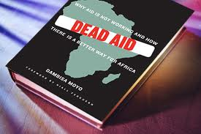
Dr. Dambisa Moyo
Author,
Zambian- born Economist
In the past fifty years, more than $1 trillion in development related aid has been transferred from rich countries to Africa. Has this assistance improved the lives of Africans? No. In fact, across the continent, the recipients of this aid are not better off as a result of it, but worse—much worse.
How can we eradicate poverty and improve the quality of life ?
Learn from Korean model of development

Slide 17
4. A Biblical Understanding of Self-Reliance
Humans are born equal. Therefore, all human beings have the right to live a healthy and prosperous life. However, many people are living in the suffering of poverty and oppression.
Creation of Man
Man
Creation of Man
Body
Spirit
Living Being
Genesis 2:7 the LORD God formed the man from the dust of the ground and breathed into his nostrils the breath of life, and the man became a living being.

Slide 18
In order to survive on this earth, we must supply our bodies and spirits with adequate nurture How exactly can nutrients be supplied?
Man
Creation of Man
Body
Spirit
Living Being
Agriculture & Work
Bible
Genesis 1: 29 Then God said, "I give you every seed-bearing plant on the face of the whole earth and every tree that has fruit with seed in it. They will be yours for food.
Genesis 9:3 Everything that lives and moves will be food for you. Just as I gave you the green plants, I now give you everything.
Matthew 4:4 Jesus answered, "It is written: 'Man does not live on bread alone, but on every word that comes from the mouth of God.'"

Slide 19
God provided men everything for their food and it is enough for man to live and survive in this world.
The next crucial question we need to ask ourselves is this:
Why is it that many people suffer from poverty?
There are many reasons
Because of Mind-set
First, Many people think poverty is fate and not try to challenge their life
Second, because of people’s greed
To solve problems;
Transformation of Mindset
Power of Gospel

Slide 20
How can we become self-reliant through the Gospel?
1) Obey God's commands
Genesis 1:28 God blessed them and said to them, "Be fruitful and increase in number; fill the earth and subdue it. Rule over the fish of the sea and the birds of the air and over every living creature that moves on the ground."
God’s Command
Self-Reliance
Subdue the earth
Cultivation of life
Rule over all creatures
The reason they cannot become self-reliant is that
they do not know how to do
Training & Education
Canaan Spirit
or Pioneering Spirit

Slide 21
2) Power of Gospel
Thessalonians 1:5 because our gospel came to you not simply with words, but also with power, with the Holy Spirit and with deep conviction. You know how we lived among you for your sake.
Practice the word of God in the Bible
Become independent and live a happy and prosperous life
in this earth.

Slide 22
God provided man everything for their food and it is enough for man to live and survive in this world.
Why is it that many people are suffering from hunger and poverty?
It is because that they don’t know how to subdue the earth and how to rule over all creatures that lives and moves on the earth
Hunger & Poverty
Improving the Quality of Life
Training & Education by Christian Spirit
Cultivation
of
Life
Learn how to cultivate soil & how to rule over all creatures
Canaan Movement is to improve the spiritual and physical quality of life by cultivation their life with transformation of mindset

Slide 23
The reason why we need ‘Canaan Movement’ is to eradicate poverty and improve the quality of life in this world.
Eradicate Spiritual
& Physical Poverty
to Improving Life
Spiritual & Physical Poverty
Training with Pioneering Spirit
Farming
Livelihood Project
Community Development
Canaan
Movement
Cultivation of Life
Canaan teach how to cultivate their life to achieve sustainable growth

Slide 24
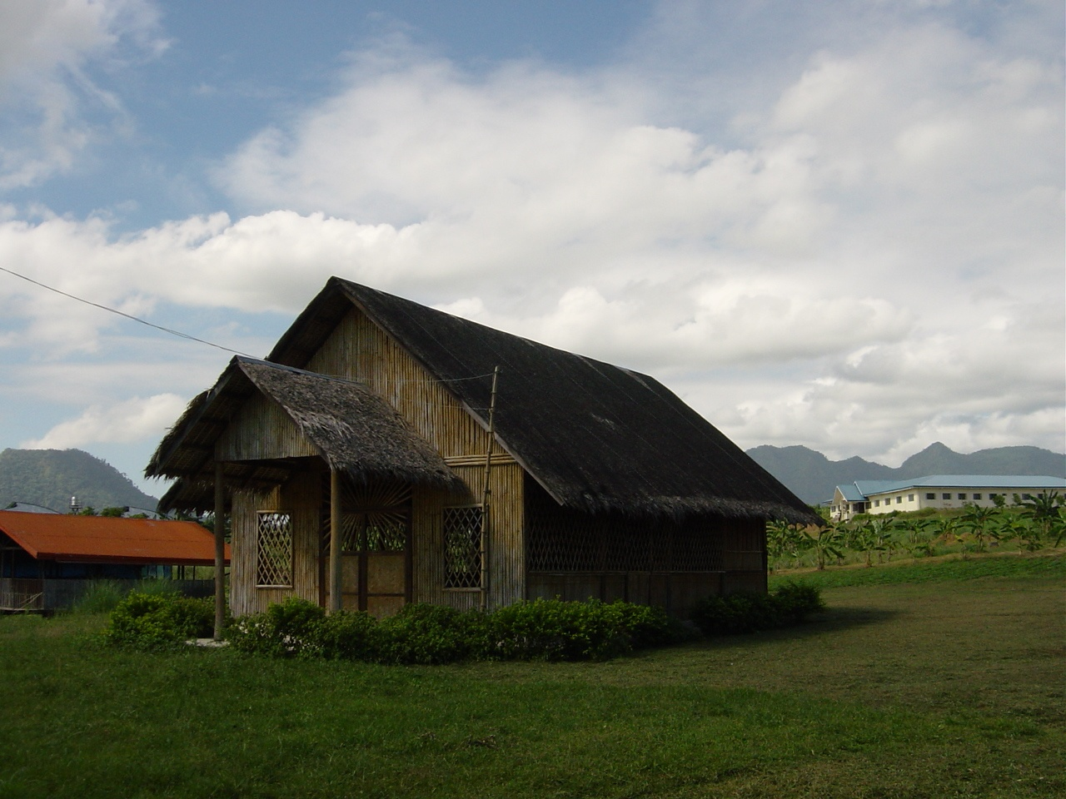
Thank You
World Canaan Movement
www.wcm.or.kr

